Slide 1
Systolic Arrays

Slide 2
Why Systolic Architectures?
Idea: Data flows from the computer memory in a rhythmic fashion, passing through many processing elements before it returns to memory
Similar to an assembly line
Different people work on the same car
Many cars are assembled simultaneously
Difference: Systolic arch. Can be non-linear and multi-dimensional
Why? Special purpose accelerators/architectures need
Simple, regular designs (keep # unique parts small and regular)
High concurrency → high performance
Balanced computation and I/O (memory access)

Slide 3
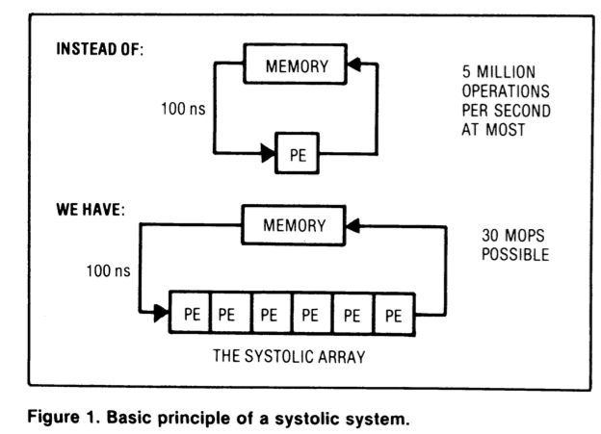
Systolic Architectures
H. T. Kung, “Why Systolic Architectures?,” IEEE Computer 1982.
Memory: heart
PEs: cells
Memory pulses
data through
cells

Slide 4
Systolic Architectures
Basic principle: Replace a single PE with a regular array of PEs and carefully orchestrate flow of data between the PEs → achieve high throughput w/o increasing memory bandwidth requirements
Differences from pipelining:
Array structure can be non-linear and multi-dimensional
PE connections can be multidirectional (and different speed)
PEs can have local memory and execute kernels (rather than a piece of the instruction)

Slide 5
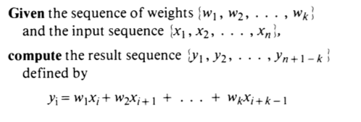
Systolic Computation Example
Convolution
Used in filtering, pattern matching, correlation, polynomial evaluation, etc …
Many image processing tasks

Slide 6
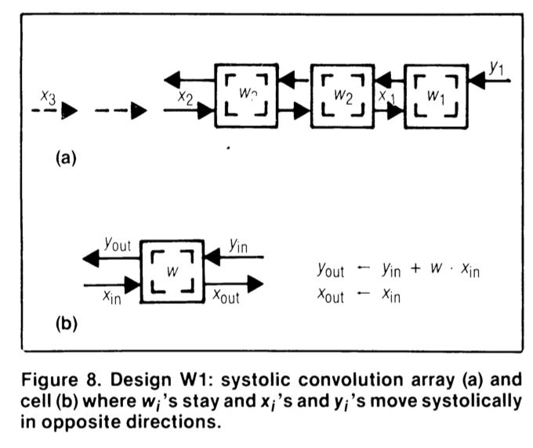
Systolic Computation Example: Convolution
y1 = w1x1 + w2x2 + w3x3
y2 = w1x2 + w2x3 + w3x4
y3 = w1x3 + w2x4 + w3x5

Slide 7
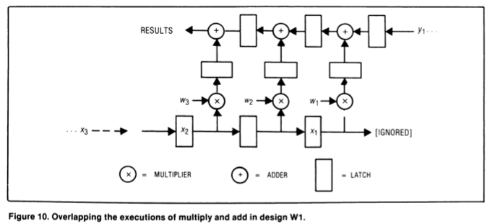
Systolic Computation Example: Convolution
Worthwhile to implement adder and multiplier separately to allow overlapping of add/mul executions

Slide 8
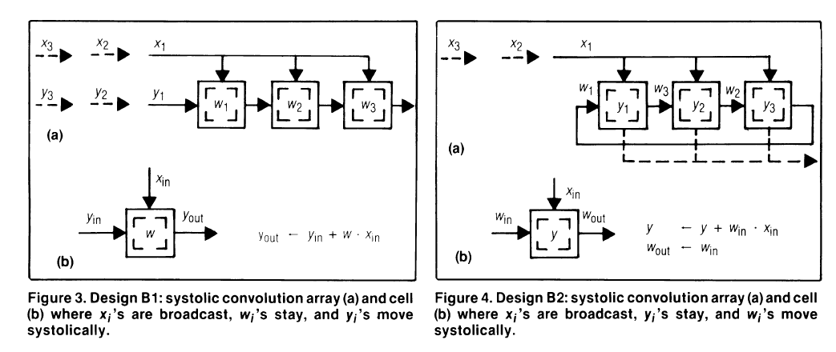
Other Examples: Broadcast Based

Slide 9
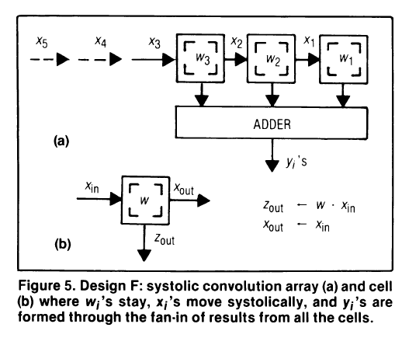
Other Examples: Broadcast Based

Slide 10
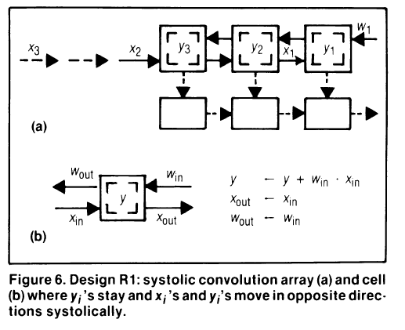
Other Examples: No Broadcast

Slide 11
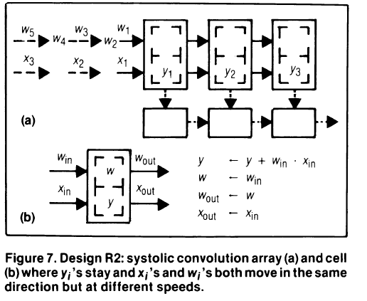
Other Examples: No Broadcast

Slide 12
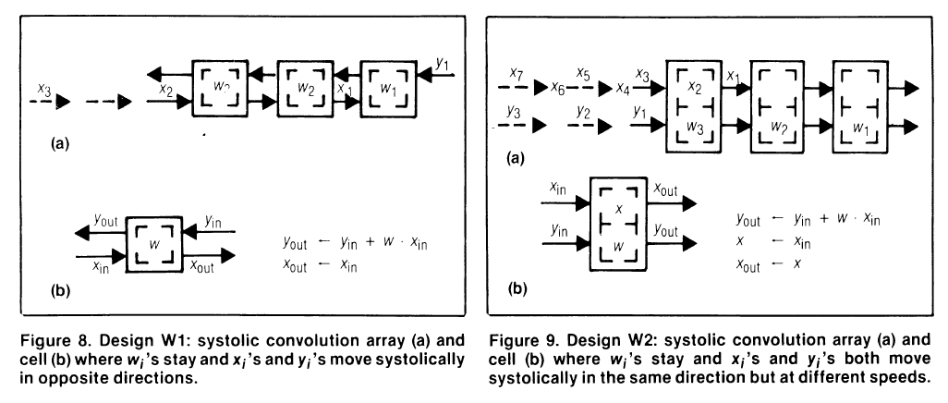
Original No-Broadcast Example

Slide 13
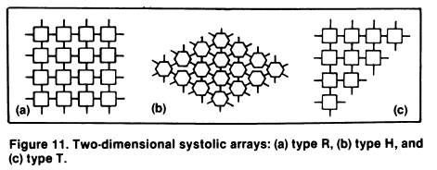
Beyond One Dimension

Slide 14
Systolic Array
Advantages
Makes multiple uses of each data item → reduced need for fetching/refetching
High concurrency
Regular design (both data and control flow)
Disadvantages
Not good at exploiting irregular parallelism
Relatively special purpose → need software, programmer support to be a general purpose model
Simplicity versus flexibility tradeoff in each cell

Slide 15
More Programmability
Each PE in a systolic array
Can store multiple “weights”
Weights can be selected on the fly
Eases implementation of, e.g., adaptive filtering
Taken further
Each PE can have its own data and instruction memory
Data memory → to store partial/temporary results, constants
Leads to stream processing, pipeline parallelism
More generally, staged execution

Slide 16
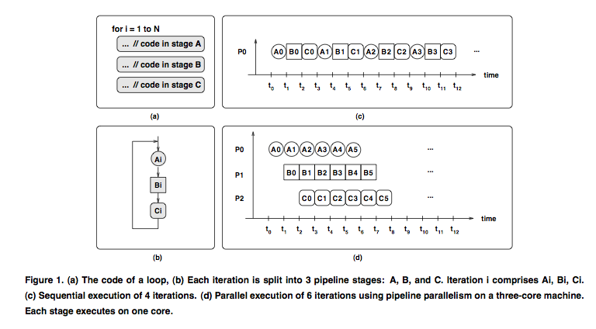
Pipeline Parallelism

Slide 17
File Compression Example

Slide 18
Pipeline Parallelism: Readings
Suleman et al., “Feedback-directed Pipeline Parallelism,” PACT 2010.
Suleman et al., “Data Marshaling for Multi-Core Architectures,” ISCA 2010.

Slide 19
The WARP Computer
HT Kung, CMU, 1984-1988
Linear array of 10 cells, each cell a 10 Mflop programmable processor
Attached to a general purpose host machine
HLL and optimizing compiler to program the systolic array
Used extensively to accelerate vision and robotics tasks
Annaratone et al., “Warp Architecture and Implementation,” ISCA 1986.
Annaratone et al., “The Warp Computer: Architecture, Implementation, and Performance,” IEEE TC 1987.

Slide 20
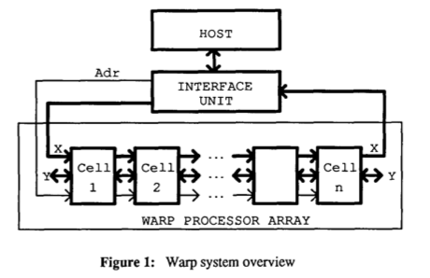
The WARP Computer

Slide 21
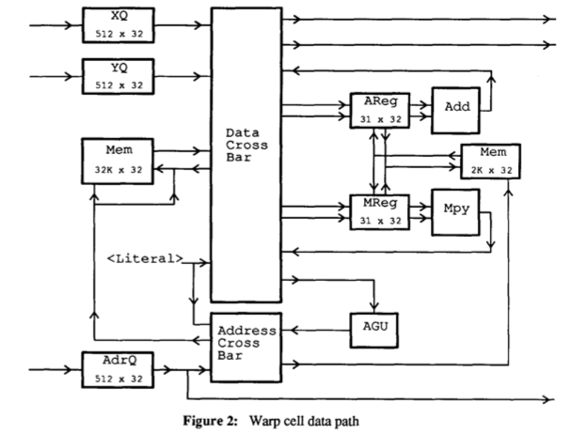
The WARP Computer

Slide 22
Systolic Arrays vs. SIMD
Food for thought…

Slide 23
Matrix Multiplication
a11 a12 a13
a21 a22 a23
a31 a32 a33
b11 b12 b13
b21 b22 b23
b31 b32 b33
c11 c12 c13
c21 c22 c23
c31 c32 c33
*
=
Conventional Method: N³
For I = 1 to N
For J = 1 to N
For K = 1 to N
C[I,J] = C[I,J] + A[J,K] * B[K,J];

Slide 24
Systolic Method
This will run in O(n) time!
To run in N time we need N x N processing units, in this case
we need 9.
P1
P2
P3
P4
P5
P6
P7
P8
P9

Slide 25
b33
b23
b13
b32
b22
b12
b31
b21
b11
a13 a12 a11
P1
P2
P3
a23 a22 a21
P4
P5
P6
a33 a32 a31
P7
P8
P9
At every tick of the global system clock data is passed to each
processor from two different directions, then it is multiplied
and the result is saved in a register.

Slide 26
3 4 2
2 5 3
3 2 5
3 4 2
2 5 3
3 2 5
23 36 28
25 39 34
28 32 37
*
=
Lets try this using a systolic array.
5
3
2
2
5
4
3
2
3
2 4 3
P1
P2
P3
3 5 2
P4
P5
P6
5 2 3
P7
P8
P9

Slide 27
Clock tick: 1
5
3
2
2
5
4
3
2
2 4
3*3
3 5 2
5 2 3
P1
P2
P3
P4
P5
P6
P7
P8
P9
9 | 0 | 0 | 0 | 0 | 0 | 0 | 0 | 0

Slide 28
Clock tick: 2
5
3
2
2
5
3
2
4*2
3*4
3 5
2*3
5 2 3
P1
P2
P3
P4
P5
P6
P7
P8
P9
17 | 12 | 0 | 6 | 0 | 0 | 0 | 0 | 0

Slide 29
Clock tick: 3
5
3
2
2*3
4*5
3*2
3
5*2
2*4
5 2
3*3
P1
P2
P3
P4
P5
P6
P7
P8
P9
23 | 32 | 6 | 16 | 8 | 0 | 9 | 0 | 0

Slide 30
Clock tick: 4
5
2*2
4*3
3*3
5*5
2*2
5
2*2
3*4
P1
P2
P3
P4
P5
P6
P7
P8
P9
23 | 36 | 18 | 25 | 33 | 4 | 13 | 12 | 0

Slide 31
Clock tick: 5
2*5
3*2
5*3
5*3
5*2
3*2
P1
P2
P3
P4
P5
P6
P7
P8
P9
23 | 36 | 28 | 25 | 39 | 19 | 28 | 22 | 6

Slide 32
Clock tick: 6
3*5
5*2
2*3
P1
P2
P3
P4
P5
P6
P7
P8
P9
23 | 36 | 28 | 25 | 39 | 34 | 28 | 32 | 12

Slide 33
Clock tick: 7
5*5
P1
P2
P3
P4
P5
P6
P7
P8
P9
23 | 36 | 28 | 25 | 39 | 34 | 28 | 32 | 37

Slide 34
Same answer! In 2n + 1 time, can we do better?
The answer is yes, there is an optimization.
23
36
28
25
39
34
28
32
37
P1
P2
P3
P4
P5
P6
P7
P8
P9
23 | 36 | 28 | 25 | 39 | 34 | 28 | 32 | 37

