Slide 1
HW/SW CODESIGN OF THE MPEG-2 VIDEO DECODER
Matjaz Verderber, Andrej Zemva, Andrej Trost
University of Ljubljana
Faculty of Electrical Engineering
Trzaska 25, 1000 Ljubljana, Slovenia
matjaz.verderber@fe.uni-lj.si

Slide 2
Hw/Sw Partitioning – Single-Spec Assumption
Assumption – Start from a single specification
Typically sw source
Partitioning
Find critical sw kernels, map some to hw
This assumption is made in most research efforts as well as commercial tools
Specification
Hw/sw partitioner
Sw
Hw
Compilation
Synthesis
Binaries
Netlists

Slide 3
Presentation outline
Motivation and basic idea
Optimization of the MPEG-2 video decoder
Timing optimization
Power consumption analysis
FPGA implementation of the MPEG-2 video decoder
System environment
Implementation in the FPGA
Implementation results
Conclusion
Motivation and basic idea

Slide 4
Motivation and basic idea
Importance of the MPEG-2 standard
Real-time requirements and low-power operation
Possibilities to use modern HW/SW technology
HW/SW optimization and implementation within one FPGA
Software tool for MPEG simulations
Analysis (time, power consumption) of the MPEG-2 decoder
Optimization (time, power consumption)
Implementation in Virtex 1600E
Timing optimization

Slide 5
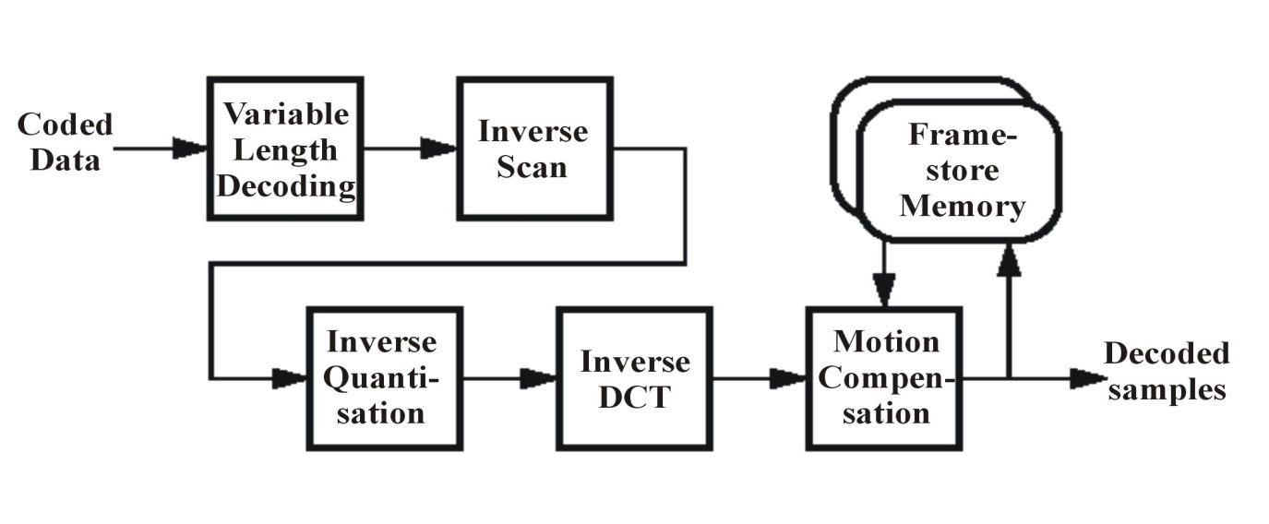
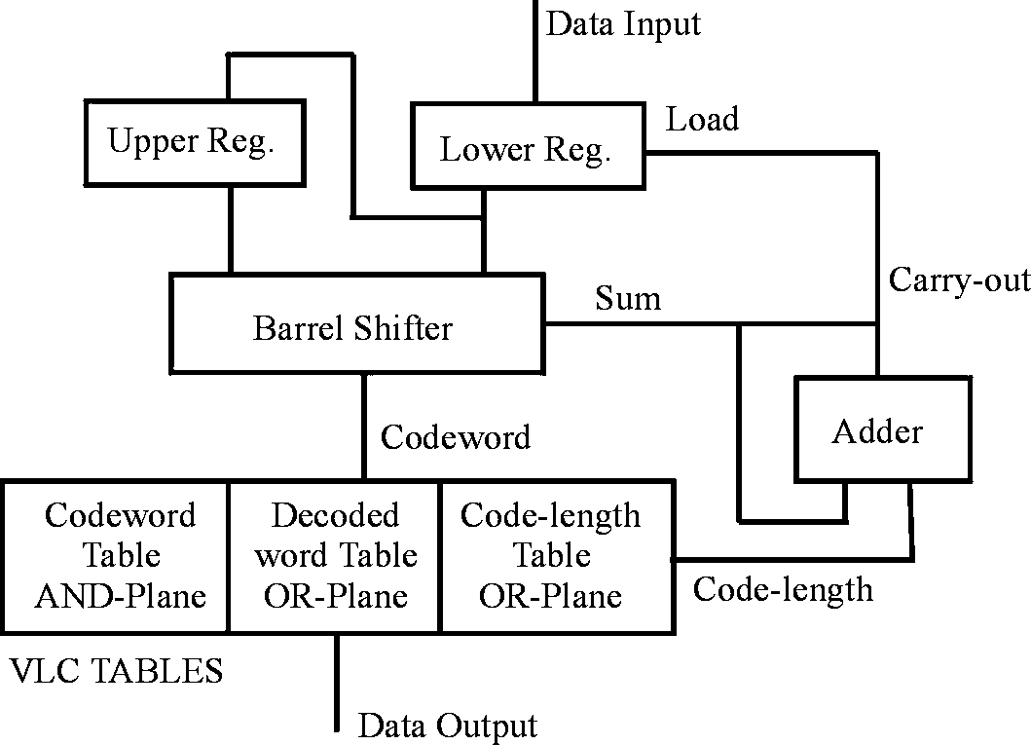
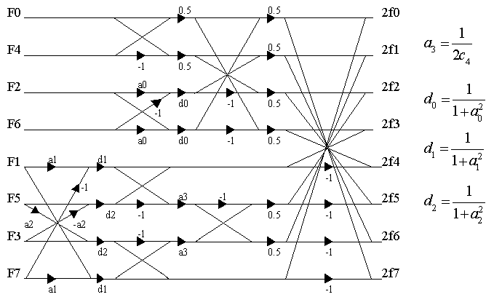
Timing optimization
ISO/IEC 13818-2 compliant software MPEG-2 decoder
Hardware implementation
Hardware implementation
Diagram of the Lei-Sun VLC decoder
Modified Chen 1D inverse DCT
Timing optimization

Slide 6
Timing optimization
Up to 40% improvement of speed for MPEG-2 decoding compared to software based solution
Decoding times for 150 sequences before and after optimization
72 MHz - estimated decoding frequency for real-time decoding (after optimization)
Power consumption optimization

Slide 7
Power consumption optimization
Conclusions have been made based on energy conscious study made by Henkel and Li
Case 1 - Quant. in HW, the rest in SW
Case 2 - 2-D DCT in HW, the rest in SW
Case 3 - 1-D DCT in HW, the rest in SW
Case 4 - Quant. and 2-D DCT in HW,
the rest in SW
Results of the case study
Correlated results by timing and power consumption optimization
System environment

Slide 8
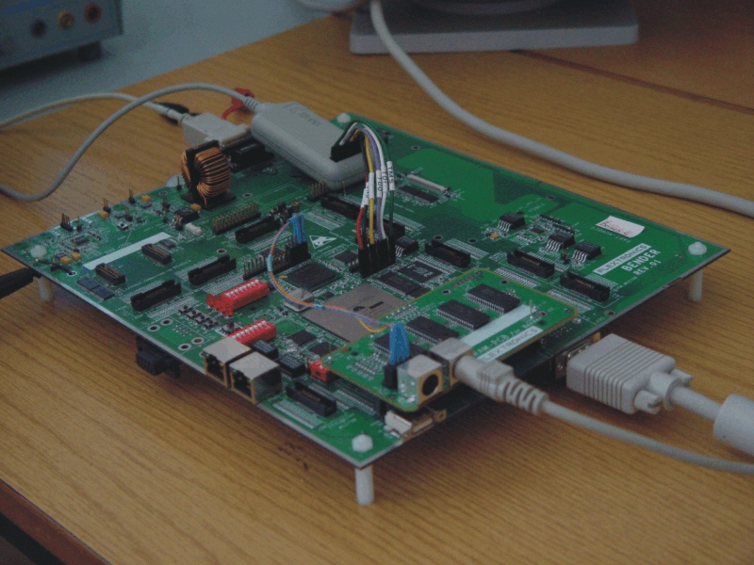
System environment
HW/SW partitioned MPEG-2 decoder has been tested on the Flextronics FPGA based prototyping board
32 Mbyte Flash
64 Mbyte SDRAM
Xilinx Virtex 1600E (2188742 system
gates, 72x108 CLBs, 589824 bits of
RAM, ...)
4 Mbyte SRAM
Several peripheral HW cores (RISC, VGA, UART, MEMC) described in Verilog
Different Linux-uClinux software tools available (GCC, GDB, Simulator, …)
Implementation in the FPGA

Slide 9
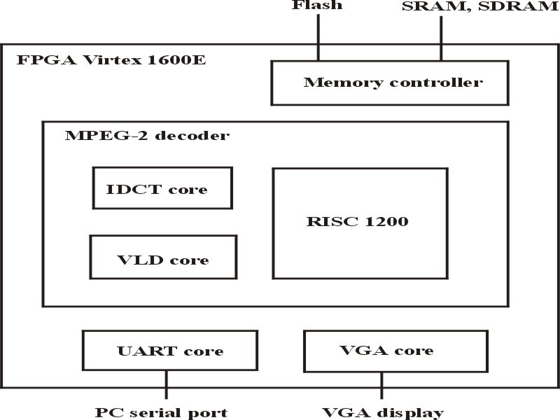
Implementation in the FPGA
Boot up sequence
Working memory
Stored MPEG-2 decoder software
Software implementation
Access to external devices
WISHBONE BUS
Hardware implementation
Display of the decoded frames
Error messages and warnings
Block diagram of the implemented MPEG-2 decoder
Implementation results

Slide 10
Implementation results
All cores described in Verilog
Synplify Pro (synthesis) and Xilinx ISE Foundation software (implementation) used
40% utilization of the Virtex 1600E
Implementation results of the MPEG-2 decoder
Conclusion

Slide 11
Conclusion
Optimized MPEG-2 video decoder by speed and power consumption
40% higher decoding speed and 36% lower power consumption
Some problems by final routing
Presentation of a modern implementation method where complex embedded system (MPEG-2 decoder) can be efficiently HW/SW partitioned

