Slide 1
SOFTWARE DESIGN FOR LOW POWER
Dr. Elwin chandra monieb

Slide 2
Mapping Resources to operations
Sum=0
for i=0 to n
sum=sum+A(i)
q

Slide 3
Software Power Issues
Upto 40% of the on-chip power is dissipated on the buses !
System Software : OS, BIOS, Compilers
Software can affect energy consumption at various levels Inter-Instruction Effects
Energy cost of instruction varies depending on previous instruction
For example, XORBX 1; ADDAX DX;
I_{est} = (319:2+313:6)=2 = 316:4mA I_{obs} =323:2mA
The difference defined as circuit state overhead
Need to specify overhead as a function of pairs of instructions
Due to pipeline stalls, cache misses
Instruction reordering to improve cache hit ratio

Slide 4
Avoiding Wastful Computation
Preservation of data correlation
Distributed computing / locality of reference
Application-specific processing
Demand-driven operation
Transformation for memory size reduction
Consider arrays A and C are already available in memory
When A is consumed another array B is generated; when C is consumed a scalar value D is produced.
Memory Size can be reduced by executing the j loop before the i loop so that C is consumed before B is generated and the same memory space can be used for both arrays.

Slide 5
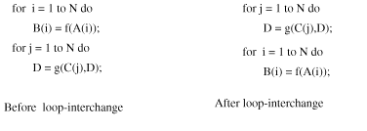
Avoiding Wastful Computation

Slide 6
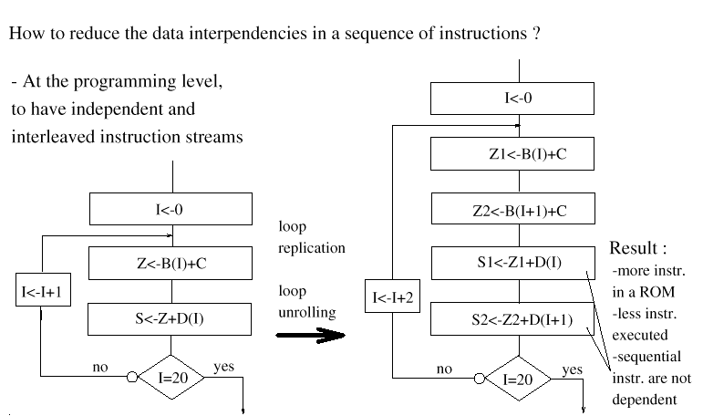
Programming Style

Slide 7
Optimizing Power using Transformation

Slide 8
Data- flow based transformations
Tree Height reduction.
Constant and variable propagation.
Common subexpression elimination.
Code motion
Dead-code elimination
The application of algebraic laws such as commutability, distributivity and associativity.
Most of the parallelism in an algorithm is embodied in the loops.
Loop jamming, partial and complete loop unrolling, strength reduction and loop retiming and software pipelining.
Retiming: maximize the resource utilization.

Slide 9
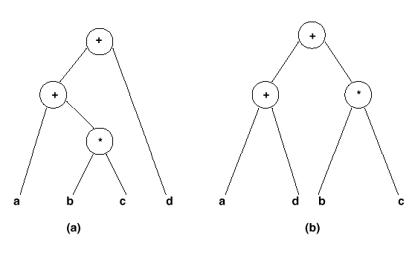
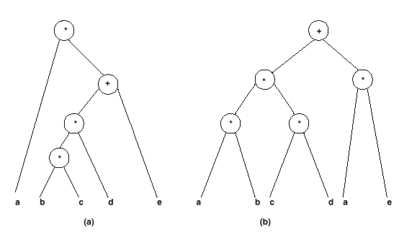
Tree-height reduction
Example of tree-height reduction using commutativity and associativity
Example of tree-height reduction using distributivity

Slide 10
Sub-expression elimination
Logic expressions:
Performed by logic optimization.
Kernel-based methods.
Arithmetic expressions:
Search isomorphic patterns in the parse trees.
Example:
a= x+ y; b = a+ 1; c = x+ y;
a= x+ y; b = a+ 1; c = a;

Slide 11
Examples of other transformations
Dead-code elimination:
a= x; b = x+ 1; c = 2 * x;
a= x; can be removed if not referenced.
Operator-strength reduction:
a= x² ; b = 3 * x;
a= x * x; t = x<<1; b = x+ t;
Code motion:
for ( i = 1; i < a * b) { }
t = a * b; for ( i = 1; i < t) { }

Slide 12
Strength reduction

Slide 13
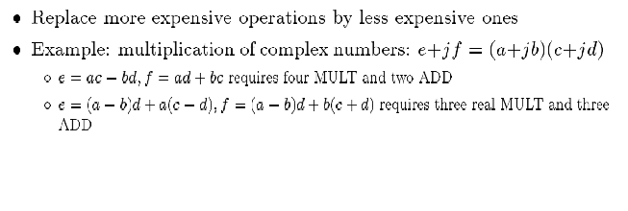
Strength Reduction

Slide 14
Control- flow based transformations
Model expansion.
Expand subroutine flatten hierarchy.
Useful to expand scope of other optimization techniques.
Problematic when routine is called more than once.
Example:
x= a+ b; y= a * b; z = foo( x, y) ;
foo( p, q) {t =q-p; return(t);}
By expanding foo:
x= a+ b; y= a * b; z = y-x;
Conditional expansion
Transform conditional into parallel execution with test at the end.
Useful when test depends on late signals.
May preclude hardware sharing.
Always useful for logic expressions.
Example:
y= ab; if ( a) x= b+d; else x= bd; can be expanded to: x= a( b+ d) + a’bd;
y= ab; x= y+ d( a+ b);

Slide 15
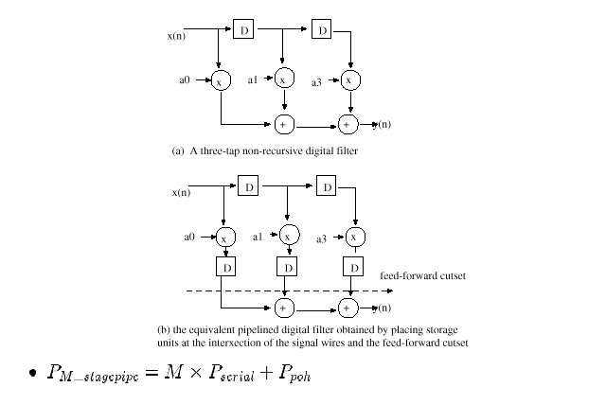
Pipelining

Slide 16
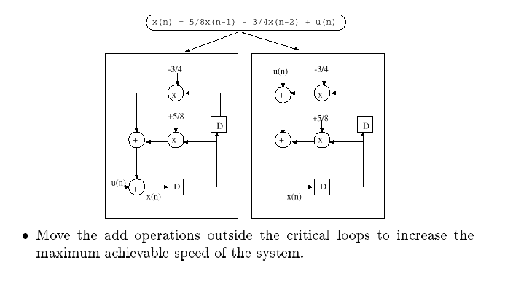
Associativity Transformation

Slide 17
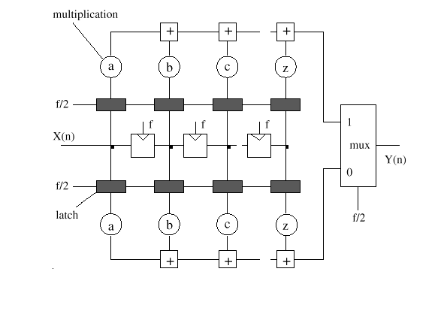
FIR Parallelization

Slide 18
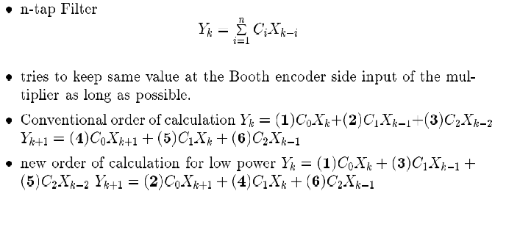
Interlaced Accumulation Programming for LowPower

Slide 19
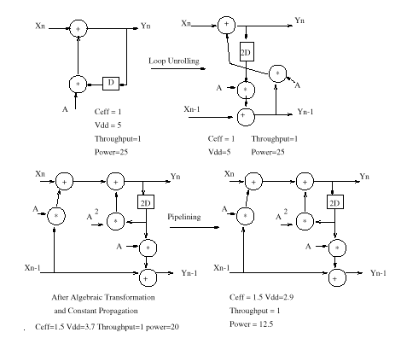
Loop Unrolling for Low Power

Slide 20
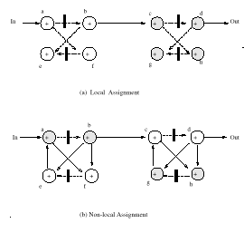
Exploiting spatial locality for interconnect power reduction
Global
Local
Adder1
Adder2

Slide 21
Exploiting spatial locality for interconnect power reduction
Global
Local
Adder1
Adder2

Slide 22
DFG Restructuring
DFG2
DFG2 after redundant operation insertion

