Slide 1
RETIMING and UNFOLDING
Dr.Elwin Chandra Monie
Dept. of ECE, RMK Engineering College

Slide 2
Transformations
Retiming and unfolding used to bring out and exploit hidden concurrency in the algorithm
Use these transformation to increase the efficiency in implementation
Refer:
Keshab K. Parhi, ‘Algorithm transformation techniques for concurrent processors’, Proc. IEEE, Dec.,1989, pp. 1879-1895

Slide 3
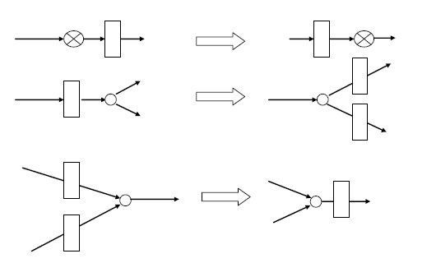
Retiming
Moving around delays without affecting the input/output characteristics of the system
Can reduce the critical path of the system
Does not alter the latency of the system
Minimize
Clock period
No. of registers

Slide 4
Nodal Transfer
3D
D
2D
v
u
Edge e
D
D
r(a) = number of delays transformed from outgoing edges
to incoming edges of node a
2D
r(v) = - 1 r(u) = 1
4D
v
u
Notes:
We illustrate the process of transfer of delays through a node without changing functionality (See [Madisetti95] for further details).

Slide 5
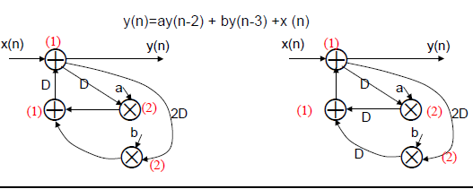
Reduction of clock period
After retiming the clock period is reduced to 2 units (33% reduction)
Placing register at the input of the nodes can reduce switching activities that leads to reduced dynamic power
1
3
2
4
Critical Path =3
Critical Path =2

Slide 6
Retiming Solution
Weight of edge from node U to node V in the retimed graph is
w_{r} (e) = w(e) + r(V)-r(U)
where r( ) is the lag parameter
e.g r(1)= 0; r(2)=1; r(3)=0; r(4)=0
w_{r} (3→2) = w(3→2) + r(2)-r(3) = 0+1-0=1
Retiming is feasible if w_{r} (e) ≥ 0 for all edges

Slide 7
Properties of Retiming
1. The weight of the retimed path
p = V₀ →V₁ →V₂ …… → V_{k} is given by w_{r}(p) = w(p) + r(V_{k}) - r(V₀)
2. Retiming does not change the number of delays in a cycle
3. Retiming does not alter the iteration bound
4. Adding a constant value to the retiming value of each node does not change the mapping from G to G_{r}

Slide 8
Proof 1
p =V₀ →V₁ →V₂ …… → V_{k}

Slide 9
Proof 2
If V_{k} = V₀
w_{r}(c)=w(c)
Then retiming does not change the no.s delays in a cycle

Slide 10
Proof 4
w_{r} (e) = w(e) + r(V)-r(U)
Add j to node V and node U
w_{r} (e) = w(e) +( r(V)+j)-(r(U)+j)
w_{r} (e) = w(e) + r(V)-r(U)
There is no change

Slide 11
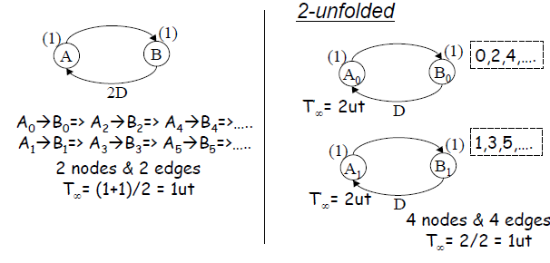
Unfolding
Unfolding is the method of processing individual iterations of the loop separately

Slide 12
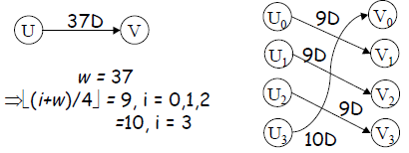
Algorithm for Unfolding
w >J
For each node U in the original DFG, draw J node U₀ , U₁ , … U_{J-1}
For each edge U → V with w delays in the original DFG, draw the J edges
U_{i} → V_{(i+w)%J} with
delays for i=0,1,2… J-1
In J unfolded DFG for w<J Unfolding of an edge with w delays in the original DFG produces J-w edges with no delays and w edges with 1 delay
J- Unfolding
J = 4

Slide 13
Properties of Unfolding
Unfolding preserves precedence constraints
Unfolding preserves the number of delays in a DFG
J-unfolding of a loop l with w_{l} delays in the original DFG leads to gcd(w_{l} ,J) loops in the unfolded DFG and each of these loops contains w_{l} / gcd(w_{l} ,J) delays and J/gcd(w_{l} ,J) copies
of each node that appears in l
J-unfolding a DFG with iteration bound
T∞ results in a iteration bound JT∞

Slide 14
Sample Period reduction
Iterative Bound T∞ is the lower bound on the iteration or sample period
But in many cases sample period cannot be equal to Iterative bound without any transformation
Cases where sample period is equal to iterative period is not possible normally
Case 1: A node in the DFG having computation
time more than iterative period
Case 2: Iterative bound is not an integer

Slide 15
Sample Period reduction …..
Unfolding allows DFG with iteration period (sample period) equal to iteration bound to be implemented
Case 1
A node in the DFG having computation time more than iterative period
Iterative bound is 3ut
Since S and T have 4ut minimum sample period possible is 4ut

Slide 16
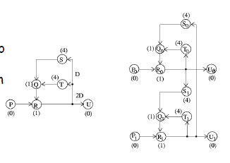
Sample Period reduction …..
2-Unfolded has iteration bound of 6ut
This unfolded DFG perform 2 iterations of the original
So the sampling period is 6/2 = 3ut, same as T∞
If the computation time of the node U, t_{u} is greater than T∞ then ⎡t_{u}/T∞⎤ unfolding should be used
t_{u}=4 ; T∞ =3
So ⎡4/3⎤ unfolding or 2-unfolding is used
2-Unfolding
2D
D
D
D

Slide 17
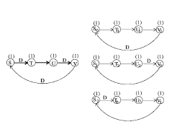
Sample Period reduction …..
Case 2
Iteration bound is not an integer
If the critical loop bound is of the form t₁/w₁ where t₁ and w₁ are co-prime then w₁-unfolding should be used
e .g. t₁=60 and w₁=45 then t₁/w₁ =4/3 and 3-unfolding should be used

Slide 18
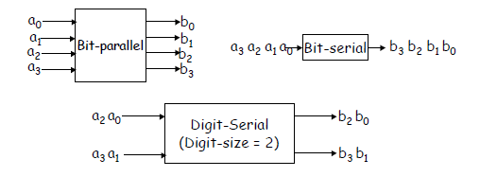
Parallel Processing
Word level Parallel Processing
Bit level Parallel Processing
Bit Serial processing
Bit parallel processing
Digit parallel processing

Slide 19
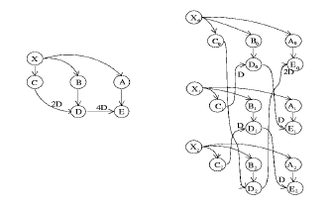
Parallel Processing …
Word serial ⇒ Word parallel
3-unfolded

Slide 20
Unfolding a node with a switch
Unfolding an edge with a switch from node U to node V
Assume
W=W’J and edge has no delays
In the unfolded graph draw from the node U_{u%J} to V_{u%J} which is switched at instance (W’l+⎿u/J⏌)

Slide 21
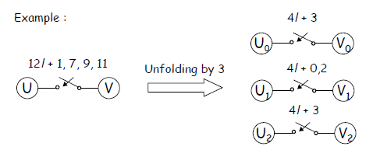
Unfolding a node with a switch …
u=1 U₁ ⇒ V₁
At 4l+0 instance
u=7 U₁ ⇒ V₁
At 4l+2 instance
u = 9 U₀ ⇒ V₀
At 4l+3 instance
u=11 U₂ ⇒ V₂
At 4l+3 instance

Slide 22
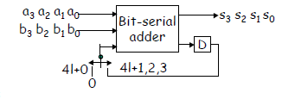
Bit-Serial to Bit-Parallel Adder
a₂ b₂
a₀ b₀
a₃ b₃
a₁ b₁
2l+0
0
+
+
A₀
S₀
A₁
S₁
D
X₀
X₁
2l+1
XX
B₀
D₀
B₁
D₁
D₀
2l+0
2l+1
Z₁
s₂ s₃
s₀ s₁
Z₀
D
Digit-serial Adder
2-unfolded

