Slide 1
PIPELINED AND PARALLEL PROCESSED RECURSIVE FILTERS
Dr Elwin Chandra Monie

Slide 2
Ist order IIR filter
Let y(n)=ay(n-1)+bu(n-1)
y(n+1)=ay(n)+bu(n) Look-ahead one step
y(n+2)=ay(n+1)+bu(n+1)
=a[ay(n)+bu(n)]+bu(n+1)
=a²y(n)+abu(n)+bu(n+1)
Look ahead M steps
{ ab, a²b,……a^{M-1}b,a^{M}} can be precomputed
Look-ahead
Computation term

Slide 3
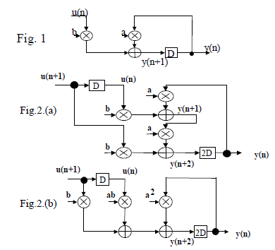
First order IIR Filter
y(n+1)=ay(n)+bu(n) Iteration bound (T_{m}+T_{a})
y(n+2)=a²y(n)+abu(n) +bu(n+1)
Iteration bound (T_{m}+T_{a})/2

Slide 4
M-Stage Pipelinable 1st order IIR Filter
Look-ahead computation allow single computation to be transformed into M concurrent Computations and to pipeline the feedback loop to get an iteration period of (T_{m}+T_{a})/M

Slide 5
Look-ahead pipelining with power-of-2 decomposition
With power -of-2 decomposition pipelined implementation can be obtained by log₂ M transformations
Let H(z)=(bz⁻¹)/(1-az⁻¹) A pole at z=a a≤1
Derived by adding M-1 poles and zeros at identical location
Complexity of the implementation is (log₂ M)+2

Slide 6
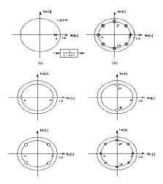
Pole-Zero position of 1st order IIR Filter
H(z) = bz⁻¹/1-az⁻¹
M=8
1
2
3
4
1
2
1+az⁻¹
1+a²z⁻²
1+a⁴z⁻⁴
1/1+a⁸z⁻⁸
3
4

Slide 7
Clustered look-ahead pipelining
Add poles and zeros such that the coefficients of
{ z⁻¹ ,……. z^{-(M-1)} } in the denominator of the transfer function are 0 and
the output y(n) can be described in terms of the cluster of N past outputs {y(n-M),…..y(n-M-N+1)}
Critical loop contains M delays and one multiplication
The sample rate can be increased by M
Used for higher order IIR filters

Slide 8
Example: 2nd order IIR filter
Poles at ½ and 3/4
2-stage pipelining by eliminating z⁻¹ term in the denominator
Multiply Numerator and Denominator by ( 1+5/4 z ⁻¹ )
x(n)
D
D
2D
5/4
-15/32
19/16
y(n)

Slide 9
Parallel processing IIR filters
Consider 1st order IIR filter
Pole is located at z=a
y(n)=ay(n-1)+u(n-1)
For 4-Parallel system using look-ahead
y(n+4)=a⁴y(n)+a³u(n)+a²u(n+1)+au(n+2)+u(n+3)
If n=4k

Slide 10
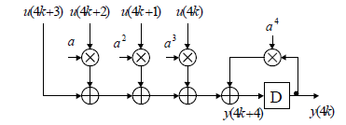
y(4k+4) =a⁴y(4k)+a³u(4k)+a²u(4k+1)
+au(4k+2)+u(4k+3)
Now pole at z=a⁴ - More stable

Slide 11
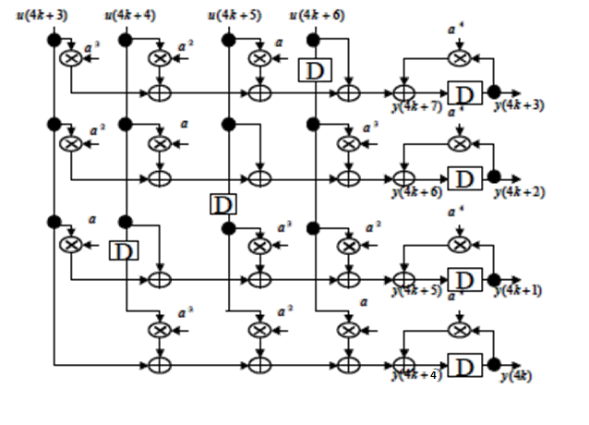
Block processing structure for L=4
Block processing structure for L=4 obtained by n=4k+4, 4k+5, 4k+6 and 4k+7

Slide 12
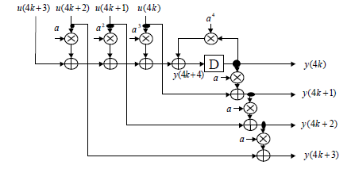
Incremental block processing
Design first the circuit for y(4k)
Then derive
y(4k+1) from y(4k), y(4k+2) from y(4k+1), y(4k+3) from y(4k+2)
y(n+1)=ay(n)+u(n)
y(4k+1)=ay(4k)+u(4k)
y(4k+2)=ay(4k+1)+u(4k+1)
y4k+3)=ay(4k+2)+u(4k+2)

Slide 13
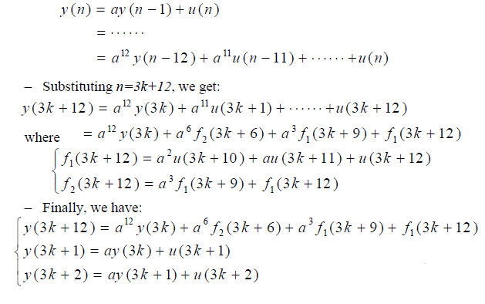
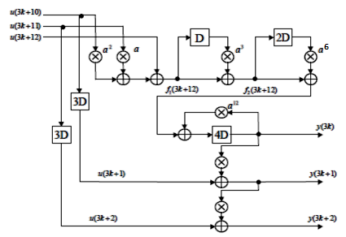
Combined pipelining and parallel processing
3- level Block processing and 4-level pipelining M=4 L=3
Multiplier complexity =(L-1)+log₂ M+1+(L-1) = 2L-1+log₂ M

