Slide 1
Introduction to CMOS Technology

Slide 2
Outline
MOSFET Basics
  Ideal MOSFET physics
  Main parameters : threshold, leakage and speed
  What MOSFET for what application ?
  Scaling theory and good design rules of CMOS Devices
The Real World
  Threshold voltage control limitations
  Gate oxide leakage and capacitance scaling
Technological Solution ?
  Gate alternative : High-K and Metal Gate
  Channel engineering : Strained-Si
  Alternative devices and substrates
  Basic logic functions

Slide 3
MOSFET Basics

Slide 4
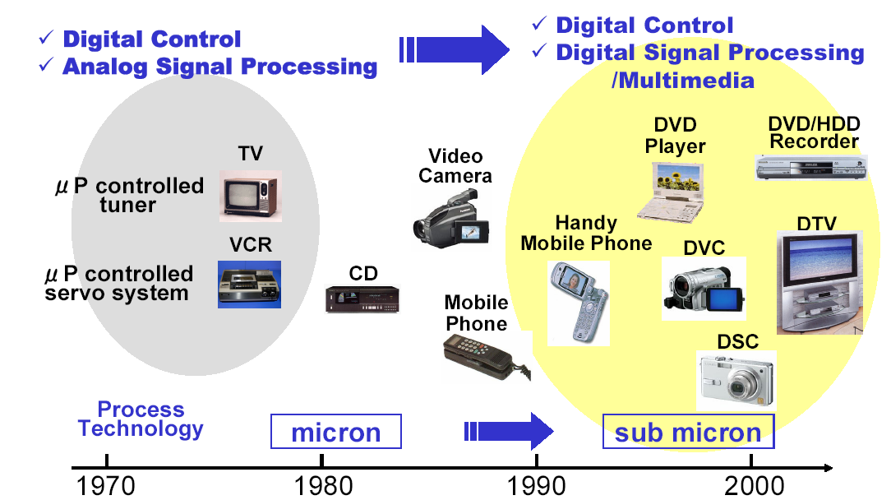

CMOS technology applications

Slide 5
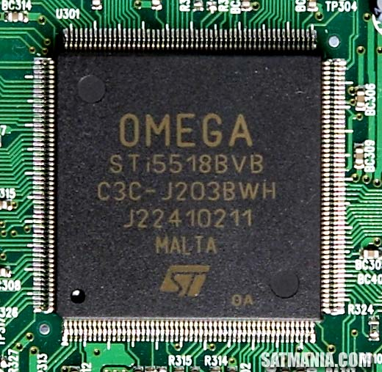
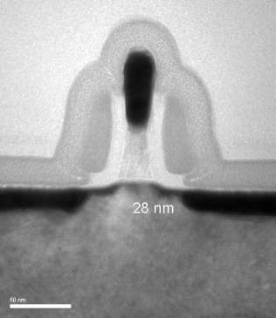
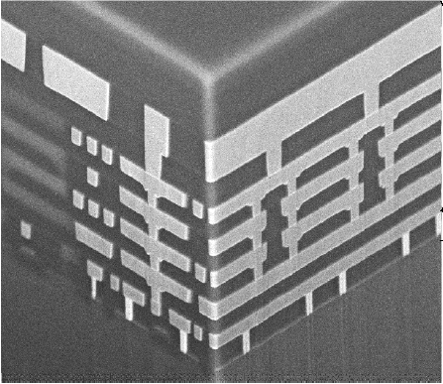
Different scales inside a chip
Gate
2x2 cm²
Source
Drain
10x10 mm²
NiSi
NiSi
Silicon channel
4x4 µm²
500x500 nm²

Slide 6
Making a Switch with Metal, Oxide and Silicon
Vg
=
C
0
Vd
Metal
S
D
Oxide
n⁺
n⁺
Si (p)
E
Energy Barrier
Energy Barrier
Carrier reservoir
Carrier reservoir
Source
Source
Drain
x
Drain
x

Slide 7
What is an ideal MOS Transistor ?
A MOS capacitor is modulating the transport between two carrier reservoir
V_{G}=0V
V_{G}>0V
G
G
V_{S}=0V
V_{D}>0V
V_{S}=0V
+ + + + + +
V_{D}>0V
S
D
S
- - - - - - -
D
I_{DS}
Canal vide : courant nul
Canal rempli : courant non nul
A
TMOS bloqué
B
TMOS passant
OFF-STATE
ON-STATE
MOS capacitance : Field Effect → MOSFET

Slide 8
n-type & p-type MOSFETs
Vg>0
Vg<0
0
Vd>0
0
Vd<0
Metal
Metal
Oxide
Oxide
n⁺
n⁺
Si (p)
p⁺
Si (n)
p⁺
nMOSFET
Electron conduction
pMOSFET
Hole conduction

Slide 9
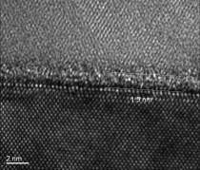
MOSFET morphology
Gate (Poly-Si)
Métal
Oxyde
Semi-
conducteur
Source
Drain
Si

Slide 10
Basic Physics of MOSFET
Log(I_{drain})
MOSFET switch
Ideal switch
3 main parameters
Threshold Voltage
Ion (=speed)
Ioff (=stand-by power)
ON state
Current
OFF state
Current
OFF State
Current (Thermal)
V_{gate}
Threshold (V_{th})

Slide 11
MOSFET Physics
nMOSFET
V_{G}=V_{D}
L
V_{G}=0
L
gate
grille
V_{D}
V_{S}
V_{D}
V_{S}
L
channel
L
source
canal
drain
Tox
source
drain
Tox
-
-
-
-
-
-
-
-
-
-
-
-
-
N
+
+
+
+
-
N
N
P
N
P
+
+
+
+
+
W_{D/C}
W_{S/C}
P
W_{D/C}
W_{S/C}
P
-
-
V_{B}
-
-
-
-
-
-
-
V_{B}
-
-
-
-
Φ_{d}
-
-
-
-
-
-
-
-
N
BC
N
N
BC
N
« Off State»
V_{D}
-
-
-

Slide 12
Threshold Voltage (V_{th})
L
gate
Channel Doping
channel
Gate Material
source
drain
W_{S/C}
P
W_{D/C}
Oxide Thickness
-
-
-
-
-
-
-
-
-
BC
N
N
V_{D}
-
-
-

Slide 13
On State Current (I_{on})
Gate
Vg-Vth
Vg-Vth-V_{DS}
L_{gate}
Source
Drain
L

Slide 14
Off – State Current (I_{off})
V_{G1}<V_{th}
V_{G1}<V_{G2}<V_{th}
I_{thermique}
I_{diffusion}
I_{thermique}
I_{diffusion}
-
-
-
-
-
-
-
-
-
-
-
-
Log I_{drain}
V_{D}>0
V_{D}>0
+ dec
I_{off}
1/S
Modulation of barrier heigth by Capacitive coupling
V_{th}
S should be as small as possible
V_{gate}

Slide 15
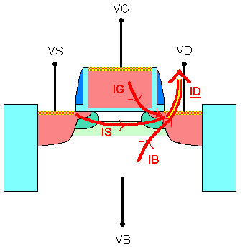
The Static Leakage Components
i) Gate leakage (oxide thickness dependance)
I_{off} = IS + IG + IB
ii) Channel Leakage (Vth and S dependant)
iii) Junction leakage (doping dependance)

Slide 16






Different Applications : Some typical numbers
Computers
Low Vth
Power Dissipation
Hifi – TV
High Vth
Mobile
Phones
Operation Speed

Slide 17
CMOS Scaling
CMOS032
CMOS045
CMOS065
CMOS090
CMOS120

Slide 18
Scaling Theory: Moore’s law
Gordon Moore, a co-founder of Intel said in 1965:
“Component count per unit area doubles every two years”
Last 40 years : technological advances achieved mainly by reducing
transistors size
- However current trend of miniaturization causes undesired effects degrading the electrical parameters and transistor performance
In reality:
µ decreases
Tox levels-off
Off current increases as transistor size is reduced

Slide 19
Ideal MOSFET Basics summary
Threshold Voltage :
  Determines the gate voltage transition V_{th} between Off-state and On-state regimes
  Vth depends (at the 1st order) on the channel doping and gate electrode material
On-State :
  MOS gate capacitance lowers channel barrier
  electrons(holes) flow from Source to Drain → I_{on} current
  Carrier transit time is Cgate*Vgate / I_{on} → the higher Ion the faster the device
Off-State :
  MOS gate capacitance potential = 0
  electrons(holes) flow from Source to Drain due to Thermionic current → I_{off} current
  Static Power dissipation is P_{stat} = V_{DS} * I_{off}

Slide 20
Part 2.
The Real World

Slide 21
V_{th} Control : Short Channel Effects
L
Zone de charge d’espace ZCE
Log I_{drain}
DIBL
SCE
SCE
DIBL
BC
V_{DS}
SCE=Short Channel Effect
Vth₂
Vth₁
V_{th}
V_{gate}
DIBL=Drain Induced Barrier Lowering

Slide 22
MOSFET Typical Lenghts and Ratios
T_{ox}
L_{gate,phys}
source
gate
drain
T_{dep}
X_{j}
L_{el}
Good design rules of MOSFET architecture :
X
j
1
T
_{ox}
1
T
_{dep}
1
V
_{th}
1
≈
;
≈
;
≈
≈
L
3
L
_{el}
30÷40
L
3
V
5
_{el}
_{el}
_{dd}

Slide 23
Scaling rules (MASTAR Model)
V_{TH}(short Mosfet)=V_{TH}(long)-SCE-DIBL
⎛
2
⎞
ε
⎜
X
⎟
T
T
Si
j
ox
dep
SCE
=
0.8
⎜
1
+
⎟
V
ε
2
bi
ox
⎜
L
⎟
L
el
L
el
⎝
el
⎠
⎛
2
⎞
ε
⎜
X
⎟
T
T
Si
j
ox
dep
DIBL
=
0.8
⎜
1
+
⎟
V
ε
ds
⎜
L
2
⎟
L
L
ox
el
el
⎝
el
⎠
1
W_{el}
I
=
μ
C
(V
-V_{th})
V
dsat
eff
ox
g
dsat
2
L_{el}
T. Skotnicki et al. IEEE EDL, March’88 & IEDM’1994

Slide 24
Why is it so difficult to get a « Good Scaling » ?
Oxide Scaling
Junction Scaling
L_{gate,phys}
source
gate
drain
T_{dep}
X_{j}
L_{el}
Doping increase
Subthreshold control

Slide 25
T_{ox}/L_{el} ratio : Gate Oxide Scaling
L_{gate,phys}
source
Poly-Si gate
drain
T_{dep}
X_{j}
L_{el}
zz
zz

Slide 26
The Gate-Poly Silicon Depletion
20
20
NMOS (
NMOS (
Npoly
Npoly
=1e20cm
=1e20cm
-
-
3)
, A
3)
, A
18
18
Tp
Tp
Tp
(EOT)
(EOT)
16
Vdd
scaled
(EOT)
16
@
@
with
Tox
@
14
14
1.8V
1.8V
1.8V
polydepletion
polydepletion
1.3V
1.3V
12
1.3V
12
1.0V
1.0V
1.0V
10
10
0.7V
0.7V
0.7V
0.5V
0.5V
8
0.5V
8
0.35V
0.35V
0.35V
6
6
0.25V
0.25V
0.25V
EOT of
EOT of
4
4
2
N+ P+
T_{dep}^{poly} = 0.4nm 0.6nm
2
0
0
0
0
10
10
20
20
30
30
40
40
CMOS relevant
CMOS relevant
Tox
Tox
, A
, A
Ref.: E. Josse et al., IEDM’99

Slide 27
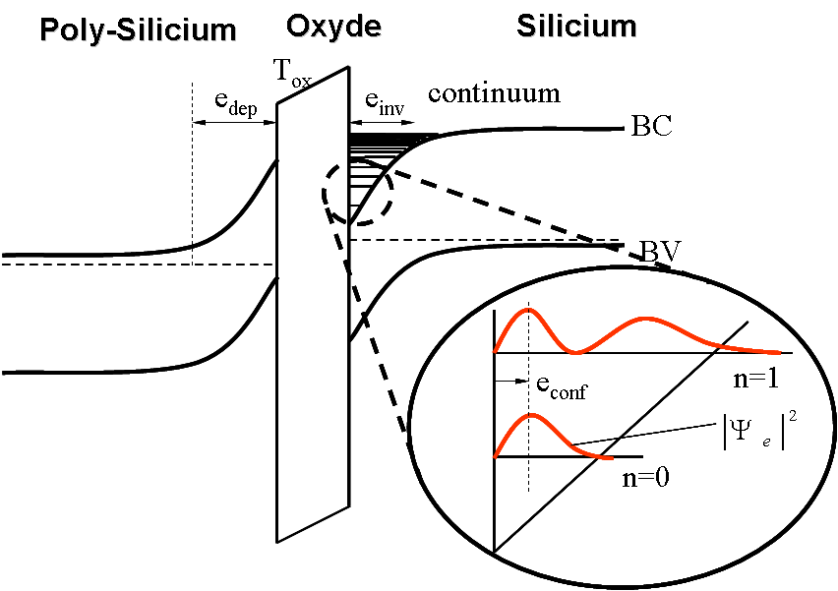
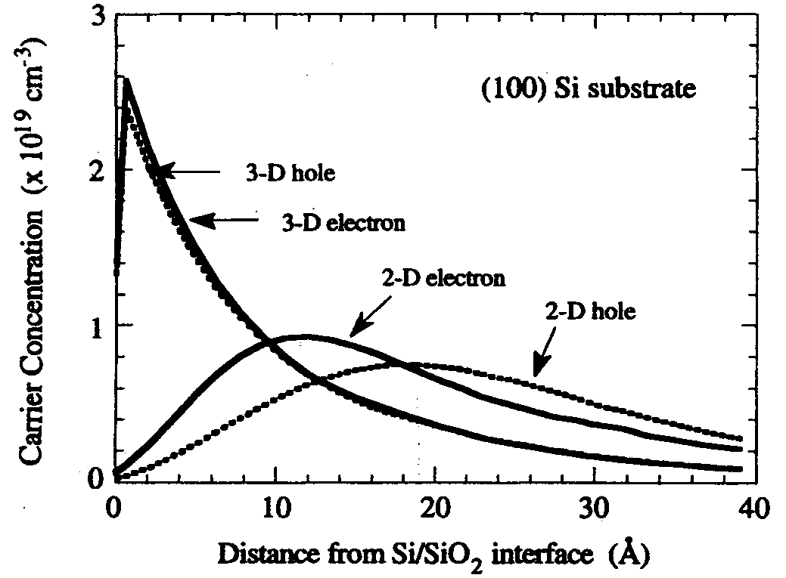
Quantization Effects in Inversion Layer
C-Y. Hu et al., IEEE EDL, June 1996
~150mV

Slide 28
Impact on Good Design Rule
Reality
Good design Rule
Tox,eff = Tox + 8A

Slide 29
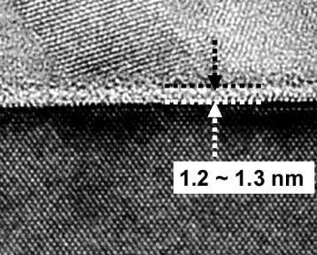
The problem of Gate Leakage
Poly-Si
Ec
Ef
Ev
Ef
Ec
2
Ev
Si
Substrate Si P
Gate N+
SiO₂
W_{pd}
2A reduction in T_{ox} ➔ ~ 1 dec increase in gate leakage

Slide 30
Impact of Gate Leakage on Circuits
0
1
0
1
0
0
Ig_{off}
Ig_{On}
Ioff_{canal}
0
0
In Static Mode, two gate leakages: Ig_{Off} & Ig_{On} : increase of Ioff
If Tox , Ig , Power

Slide 31
V_{th}/V_{dd} Ratio
If V_{dd} drops, just decrease the V_{th} too keep a good Ion. But …
Log(I
DS
)
S degrades at smaller L !
I
off
V
V
gs
th

Slide 32
What Did We Learn ?
Controlling V_{th} (→I_{off})
Increasing Doping
Junc. Leak.
I_{off} (power) increase
Scaling Jonctions
Rs increase
I_{on} (speed) reduction
Scaling Tox
Gate leakage
Higher I_{off}
Darkspace
Limited Scaling
I_{on} reduction
Polydepletion
Reducing Vdd (power)
I_{on} reduction

Slide 33
Technological Boosters to recover a Healthy Scaling

Slide 34
What can we do to retrieve a Healthy Scaling ?
Oxide Scaling
Junction Scaling
Gate
Low RSD for lower Xj
Better Contact Resistance
Less Gate Lekage
No Poly Depletion
Subthreshold control Vs Overdrive
Source
Drain
Doping increase
NiSi
NiSi
Silicon channel
Better Ion at the same overdrive
Better Subthreshold Slope
DIBL-Free Architecture

Slide 35
Mobility Enhancement

Slide 36
I_{on} Enhancement by materials
Transistor Architecture
Material Properties
Velocity saturation regime
Velocity
Carrier velocity under electric field E in the linear regime: v = µ E
µ
E_{critical}
E_{field}

Slide 37
Mobility In Silicon
E
2
E
v
=
c
Shockwave from lattice vibration, or impurities, or gate oxide rugosity every τ seconds
m
*
Small m* : ligth electrons or holes
carrier, mass m*
2. High τ (less possible collision)
τ
µ
=
q
m
*
Effective mass of carrier
Linked to valence/conduction bands

Slide 38
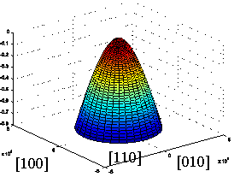
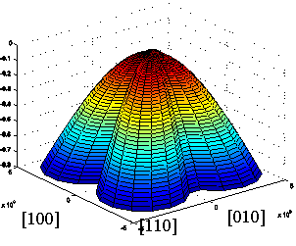
Who are the guys responsible for I_{on} ?
Silicon Band Structure
(z) 001
m_{l}
m_{t}
(y) 010
(x)100
6 equivalent types of electrons are involved in conduction regime of nMOS
2 types of holes are involved in conduction regime of pMOS : heavy and light

Slide 39
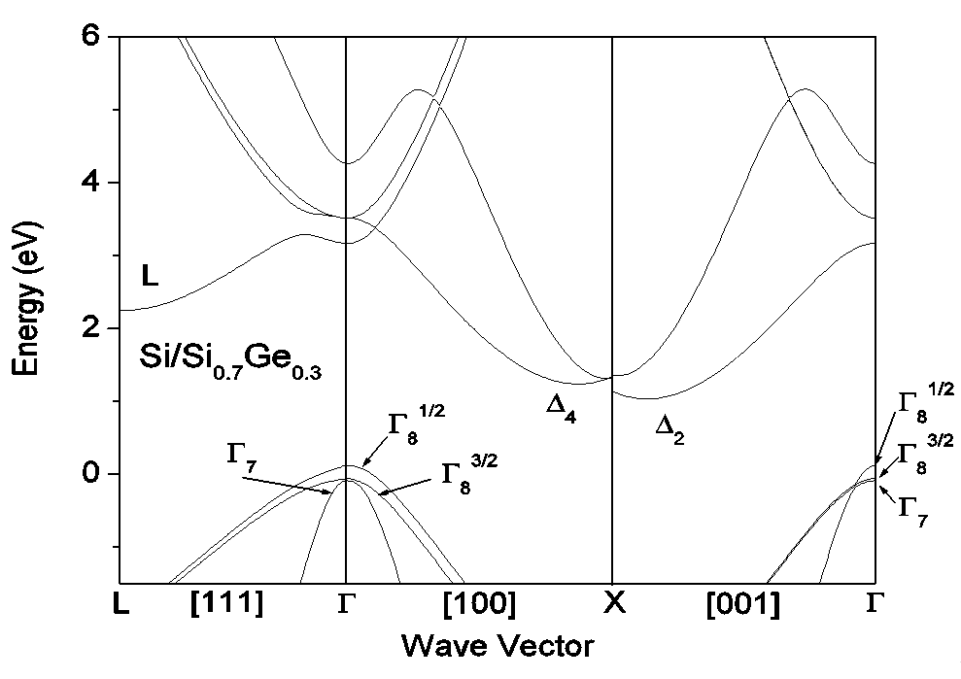
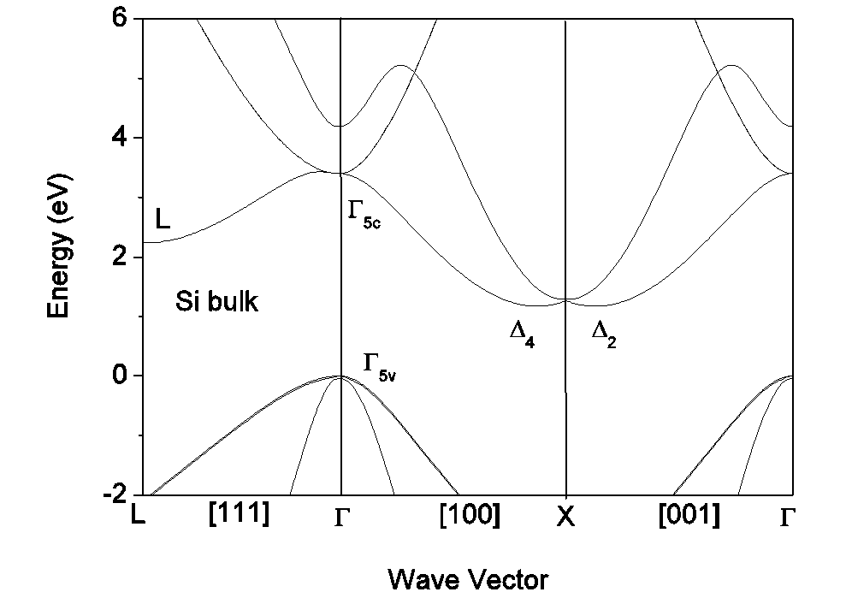
What happens in Strained-Si ?
τ
Splitting ➔less intervalley
phonon scattering
Splitting ➔Sub-band
Carrier Redistribution
Band structure
deformation

Slide 40
Redistribution in subbands and scattering reduction
N
Fermi-Dirac
Unstrained Si
Strained-Si
>80 % in HH
< 1 % in HH
E

Slide 41
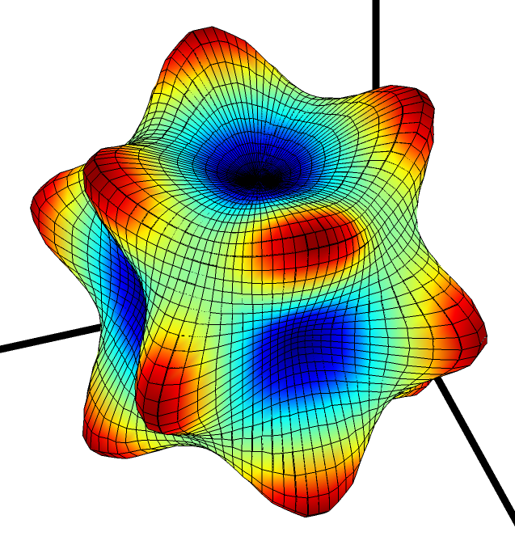
Is Stress the Only Way to Enhance Mobility ?
Carrier effective mass can depend on cristal direction !
  For Electron iso-energy are ellipsoidal → average dependance does not depend on Si direction for standard (100) substrate (not true in other direction)
  For Hole : extremely high anisotopy of mass !!
Heavy Mass
Holes with the same energy
Cristal Direction (3D)
Light Mass

Slide 42
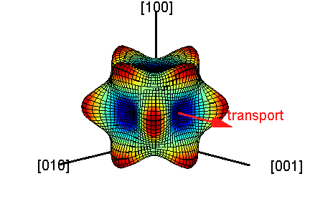
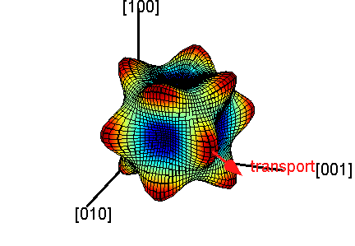
Choosing the right Si-orientation for Holes
Standard (100) wafer
Standard (100) wafer
45° Rotation
Heavy Mass along transport
Standard <110> channel
Light Mass along transport
Rotated <100> channel

Slide 43
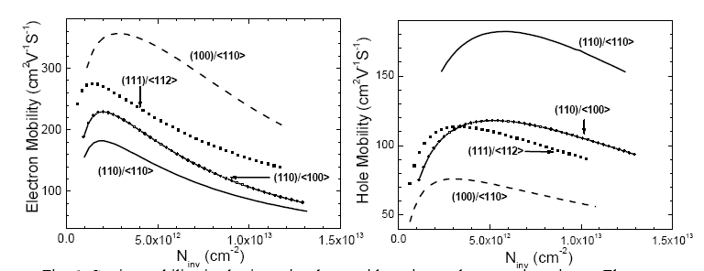
Optimum Cristal Orientations
Inversion layer mobility depends on the surface orientations and current flow directions
For holes, mobility is 2.5x higher on (110) surface compared to standard wafer with (100) orientation
For electrons, mobility is highest on (100) substrates
nMOS
pMOS
From M.Yang et al., IEDM 2004

Slide 44
Hybrid integration
To fully take advantage of the carrier mobility dependence on surface orientation, fabrication of CMOS on hybrid substrates has been demonstrated
The hybrid substrate is obtained using a layer transfer technique in which the bonded wafer and the handle wafer have different crystal orientation. An additional photo step is used to etch through the SOI and BOX and expose the surface of the handle wafer to perform SEG
Issues : limited scalability of bulk devices and increased process complexity
[M. Yang et al.,
IEDM 2003]

Slide 45
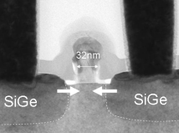

Mobility Enhancement Techniques
Substrate-based
Process-based Induced Stess
Si_{x}Ge_{1-x} Based
Cristal Orientation
Liners
SiGe SEG
STI
Bulk
SSOI
In-plane
Out of plane
CESL
SMT
SiGe SD
SACVD
Tensile bi-axial stress
Natural mobility boost
Tensile
Tensile
Compressive
Tensile
Bi-axial
nMOS
nMOS
nMOS+pMOS
nMOS+pMOS
pMOS
Compressive
Si
Mod.Orientation Si Channel
pMOS
pMOS
^{SiGe}
^{box}
Rotated substrate
Cristal Orientation
BULK
SSOI

Slide 46
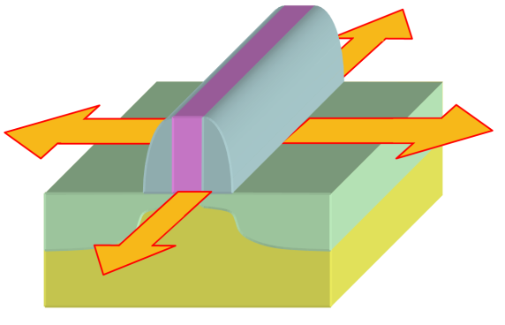
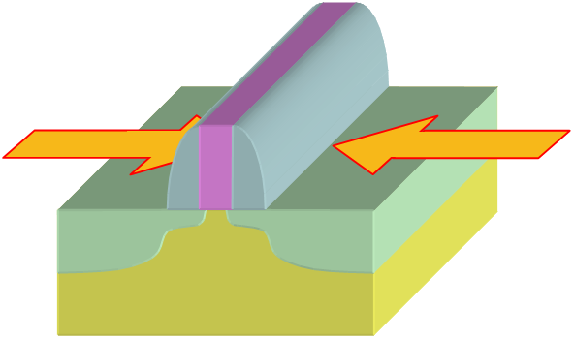
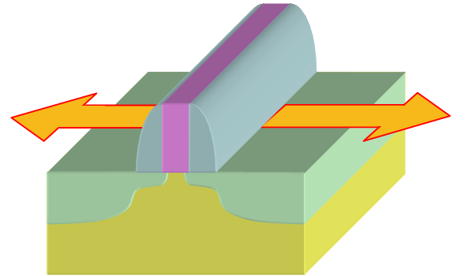
Strain and mobility
Low field mobility | Electrons | Holes
Biaxial tensile | + | +
Biaxial compressive | - | +
Uniaxial tensile (along L_{g}) | + | -
Uniaxial compressive (along L_{g}) | - | +
Biaxial tensile
Uniaxial compressive
(along L_{g})
Uniaxial tensile
(along L_{g})
[F. Payet, L2MP PhD, 2006]

Slide 47
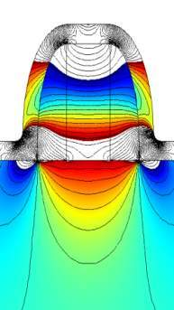
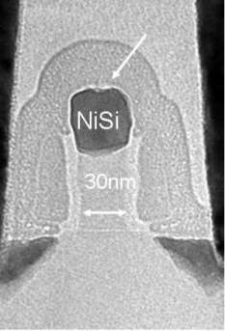
Uniaxial Stress By Stressed-Liner
Strained MOSFET (Lg=30nm) by CESL
2D mecanical Simulations
Impact on nMOSFETs performances
CESL Tensile
Tension
(F.Bœuf et al., IEDM 2004 , SSDM 2004)

Slide 48
Hole Mobility enhancement using Rotated Substrates
45°
<100>
<110>
Current
Flow

Slide 49
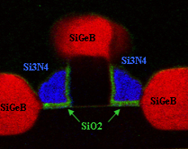
Uniaxial Stress using SiGe S/D
<110> unstrained
T.Korman
+15%
Courtesy, F.Payet

Slide 50
Gate Capacitance Scaling : High-K dielectrics

Slide 51
Figthing against Gate Leakage
Reducing Tunneling…
→Increasing T_{ox} !
But without reduction of Cox !
→Increasing permitivity
→ HIGH K materials
Leakage issue
Ec
Ef
Ev
Ef
Ec
Ev
Substrate Si P
Gate N+
SiO₂
Polydepletion issue
W_{pd}
Replacing Poly-Si by Metal

Slide 52
Context
Figthing against Gate Leakage
Down to 90nm gate length, N+ and P+ polysilicon gate was used for CMOS integration compatible with oxide or oxynitride gate dielectric.
Due to aggressive scaling of the gate dielectric, the gate leakage is becoming unacceptably high (>Ioff), requiring the use of high-k dielectric
Due to the incompatibility of polysilicon gate with high-k dielectric (Fermi pinning, large Vt, mobility degradation) and the need to boost performance (elimination of polydepletion, boron penetration,…), metal gate electrodes will likely be needed
For bulk technology, two metals with WFs close to the bandgap edges are needed (high channel doping required to control SCE).
For FDSOI or double gate devices, WFs within 250meV from midgap are preferred, requiring more complex integration
Two integration approaches are considered: gate first and gate last.

Slide 53
High-k dielectric
For EOTs below 20Å, gate leakage current
becomes higher than off-state leakage current.
High-k dielectric
High-k (HfO2, ZrO2, Hf-based or Zr-based,
LaO2, Al2O3,… ALCVD or MOCVD deposition
Pre-deposition clean and post deposition
anneals affect the quality of high-k
Large Vt: Fermi pinning at the poly-Si/
Metal oxide interface but occurs also metal gate electrodes
100
FD SOI nMOS, Vg = 1.1V
10
Exp data.
2 Dec
MASTAR
1
Poly-Si/SiON
0,1
1 Dec
J_{g} _{ON} (A/Cm²)
0,01
0,001
MG/SiON
2 Dec
0,0001
MG/Hf SiON
MG/HfO₂
0,00001
17
19
21
23
25
27
CET (A)
C. Fenouillet et al IEDM 2007
Compatibility of polysilicon gate with high-k is unlikely !
High-K → At an equivalent CET of SiON dielectric, the gate leakage current is reduced by more than 2 decades

Slide 54
High-k Dielectric : Issues
Mobility degradation
  - Many publications have reported mobility degradation using high-k dielectrics.
  Possible cause is coupling of soft optical phonons in high-k with inversion channel charge carrier
Vt instabilities and reliability and noise issues
Large k and large dielectric thickness result in fringing field (FIBL) and loss of control of the channel by the gate
B. Tavel et al, PhD Thesis 2002

Slide 55
Gate Capacitance Scaling : Metal Gates

Slide 56
Choosing The « Good Metal »
nMOS Gate
poly-Si N+
Ec
Metal Gate « N+like »
Mid-gap Gate
1.12V
Ev
pMOS Gate
poly-Si P+
Metal Gate « P+like »

Slide 57
Metal gate integration
The use of metal gate suppress:
  the polysilicon depletion : a reduced CET of 3-5Å for performance improvement
  and suppress the boron penetration problem
Two approaches have been proposed: gate first or gate last
  Gate first approach requires to take care of FE contamination tool, metal etching and to the high temperature anneal
  Gate last approach (replacement gate): dummy gate removal and replacement, gate dielectric integrity has to be kept
  But for some applications CMOS requires 2 different metal gates in order to separate WFs for NMOS and PMOS devices (Dual metal gate integration)

Slide 58
Why is Metal Workfunction so important ?
Regular Poly-gate n+/p+
Mid-gap Metal Gate
Dual n+/p+ Metal Gate
Log I_{d}
Log I_{d}
Log I_{d}
+0.5V
+0.5V
V_{th},p
V_{th},n
V_{th},p
V_{th},n
V_{th},p
V_{th},n
V_{g}
V_{g}
V_{g}
+25%
Polydep
reduction
I_{d}
I_{d}
I_{d}
I_{on},n
I_{on},p
I_{on},n
I_{on},p
I_{on},p
I_{on},n
V_{g}
V_{g}
V_{g}
V_{dd}
V_{dd}
V_{dd}
V_{dd}
V_{dd}
V_{dd}

Slide 59
Metal gate interest for FDSOI
Why midgap metal gate ?
Midgap electrode with undoped channel : symmetrical V_{th} for NMOS and PMOS for high Vth applications
With Band edge gate electrodes (as poly-Si), FDSOI requires very high channel doping > 8e18 at/cm3 for HVT -> Variability degradation
Why high-k ?

Slide 60
Device Architecture

Slide 61

Device Architecture
Xj
T_{dep}
GP
DG
(Delta, FinFET, SON, Vertical,
TriGate, Omega, etc., etc.
Bulk
PD SOI
FD SOI
FD SON
Scalability ?
Scalability
as BULK
Scalability may be better or worse (GP,BOX)
Scalability
much improved
if GP
Scalability very much improved
REF.:T. Skotnicki, invited paper ESSDERC 2000, pp. 19-33, edit. Frontier Group

Slide 62
Layout and basic functions

Slide 63
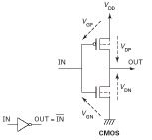
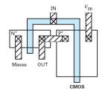
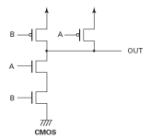
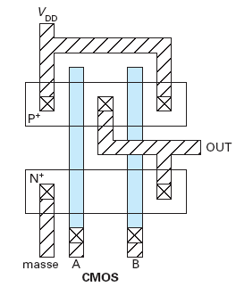


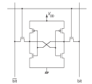
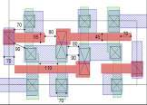
Logic Applications
Basic Functions
inverter
Layout
Silicon
Complex Function
(MP4 Decoder,
µProc,
Motion
Detector, TVDH …)
Layout
NAND
SRAM
Layout

Slide 64
Layout of the transistor
Gate
Contact
Metal 1
Gate
Source
Drain
Metal 1
Metal 1
Source
Drain
Contact
Contact
Vg>0
Si=Active
isolation
0
Metal
Vd>0
Oxide
n⁺
n⁺
Si (p)

Slide 65
Design rules
Design Rule Manual (DRM)
  Document that gives the design rules for a technology node
  Gives the minium dimensions for each level
  Give the minium distance between two levels
The design rules give the maximum density achievable for a technology node
Poly-active
W
Poly-contact
Active-contact
Diam. contact
Si=Active
L_{poly}

Slide 66
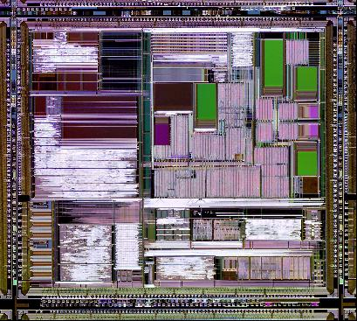
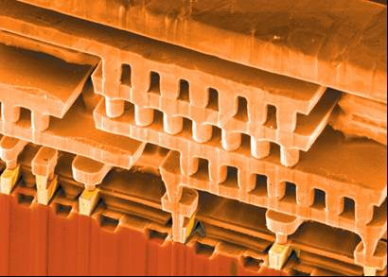
Circuit cross-section
Interconnect
Transistors

Slide 67
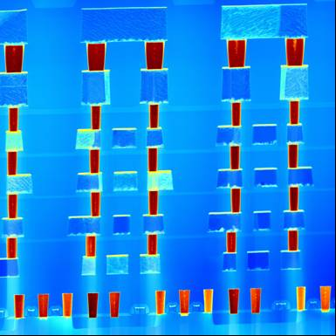
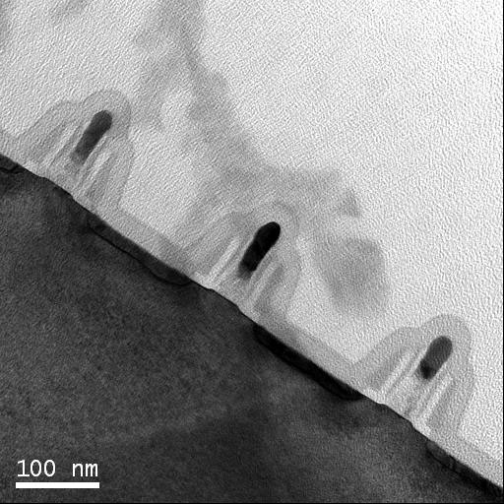
FEOL & BEOL
Metal 6
Metal 5
BEOL = Back End Of Line
Metal 4
Metal 3
Metal 2
Metal 1
MOSFETs
FEOL=Front End of Line

