Slide 1

Low Power VLSI Design
Dr Elwin Chandra Monie
RMK Engineering College
Free Powerpoint Templates

Slide 2
Topics for discussion
Need for low power design
Sources of power dissipation
Levels of power optimization
Design for low power
Estimation of power
Advanced techniques in power reduction
Software design for low power
Text Book:
Practical low power Digital VLSI Design,
Gary Yep
Kluwer Academic Publications, 1998

Slide 3
Need for Low power design

Slide 4
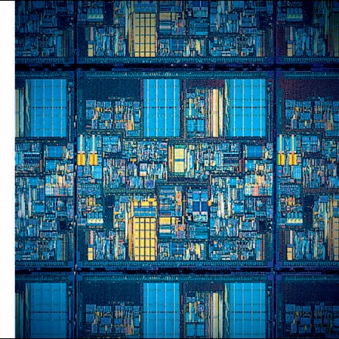
IC Generation
First Planner IC 1961
2 transistors
Pentium 4 - 2001
42 Million Transistors

Slide 5
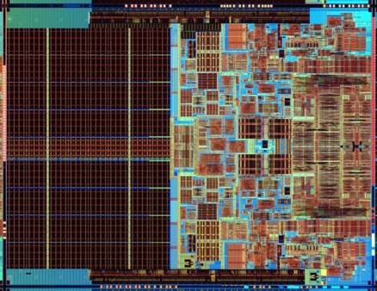
Gallery - Current Processors
Intel Core 2 Duo “Conroe”
291M transistors / 2.67GHz / 65W
L=65nm Area=143mm²
Image courtesy Intel Corporations
All Rights Reserved

Slide 6

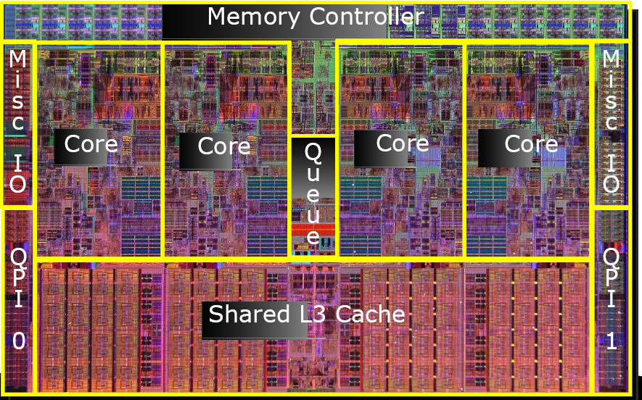
45nm 4 Cores 2.67-3.3 GHz L3 8MB 0.8-1.35V 130W 1.4 Billion
22nm 4 cores 3.4GHz L3 8MB 65W

Slide 7
Moore’s Law 1965
Gordon E. Moore
Fairchild
Number of transistors will double in 18 to 24 months
Still valid and trends show it will be valid for a few years

Slide 8
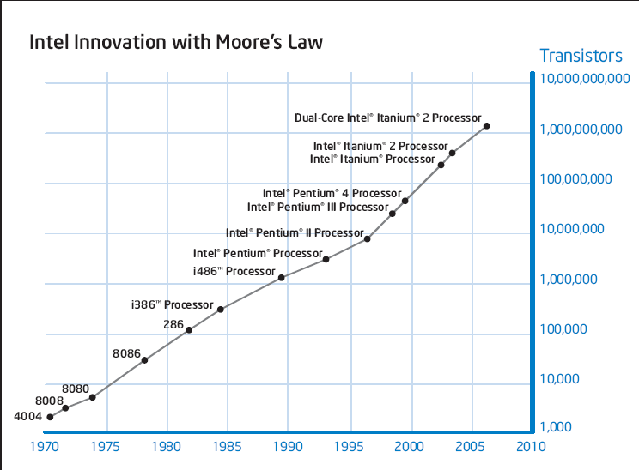
Moore’s Law - Processors
2x Growth in 1.96 years
Expected to reach Tera capability in 2010

Slide 9
Technology Trend

Slide 10
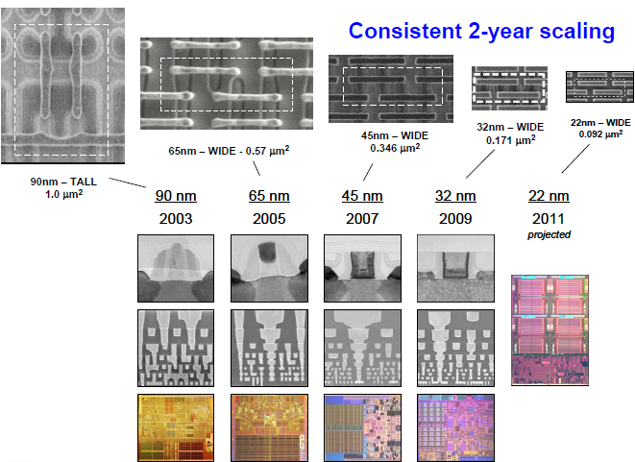

Slide 11
Integrated Circuit Complexity

Slide 12
Clock Frequency
10000
1000
2X every 2 years
100
P6
Pentium ® proc
Frequency (Mhz)
486
10
8085
386
8086
286
Lead microprocessors frequency
doubles every 2 years
1
8080
8008
4004
0.1
1970
1980
1990
2000
2010
Year
Courtesy, Intel
Notes:
Causes: shrinking feature size and increased pipelining

Slide 13
Chip Power Density
10000
1000
Nuclear
100
Reactor
Power Density (W/cm2)
8086
Hot Plate
10
4004
P6
8008
8085
386
Pentium®
8080
286
486
1
1970
1980
1990
2000
2010
Year

Slide 14
100000
18KW
10000
5KW
1.5KW
1000
500W
Pentium® proc
Power (Watts)
100
286
486
10
8086
386
8085
8080
1
8008
4004
0.1
1971
1974
1978
1985
1992
2000
2004
2008
Year
Power delivery and dissipation will be prohibitive
Courtesy, Intel

Slide 15
Power factor

Slide 16
Battery
Portable consumer electronics powered by battery
Battery is heavy and big
Energy density barely doubles in several years
Safety concern: the energy density is approaching
that of explosive chemicals.
The battery technology alone
will not solve the low power problem

Slide 17
Reliability and Cooling Costs
High power dissipation → high temperature → malfunction
High performance microprocessors: ~50 Watts (a hand-held soldering iron)
Packaging cost and cooling cost: fans
Power supply rails: high transient current (e.g. 3A).

Slide 18
Environmental Concerns
Office automation equipment
  5% of total US commercial energy in 1993
  10% of total US commercial energy in 2000
Electricity generation→ air pollution and consumption of energy sources
Trends towards GREEN Chip

Slide 19
Sources of Power dissipation in CMOS Circuits

Slide 20
Sources of Power Dissipation in CMOS
Dynamic Power Consumption
  charge and discharge capacitors
Short Circuit Current
  short-circuit current path between supply rails during switching
Glitch power dissipation
Leakage
  Leaking diodes and transistor

Slide 21
Dynamic Power Dissipation
Dynamic power is required to charge and discharge load capacitances when transistors switch.
One cycle involves a rising and falling output.
On rising output, charge Q = CΔV = C_{L}V_{DD} is required.
On falling output, charge is dumped to GND.

Slide 22
Dynamic Power Dissipation..
Assume that one cycle of charge-discharge completes in one clock peroid T_{CLK} i.e. VIN is the CLK:
Do not depend on R_{N} and R_{P}
Not a function of transistor size
Notes:
27

Slide 23
Power drawn from source

Slide 24
Lowering Dynamic Power
Capacitance:
Function of fan-out, wire length, transistor sizes
Supply Voltage:
Has been dropping with successive generations
P_{dyn} = C_{L} V_{DD}² P_{0→1} f
Activity factor:
How often, on average, do wires switch?
Clock frequency:
Increasing…
Notes:
Lowering C_{L}
Improves performance as well
Keep transistors minimum size (keeps intrinsic capacitance (gate and diffusion) small)
Transistors should be sized only when C_{L} is dominated by extrinsic capacitance (fanout and wires)
Reducing V_{DD} has a quadratic effect!
But has a negative effect on performance especially as V_{DD} approaches 2V_{T}
Reducing the switching activity, f_{0→1} = P_{0→1} * f
A function of signal statistics and clock rate
Impacted by logic and architecture design decisions
One alternative is to lower the supply voltage as much as possible and to compensate for the loss in performance by increasing the transistor sizes. Yet this causes the capacitance to increase. At a low enough supply voltage, the capacitance (for speed) may start to dominate the power equation causing energy to increase with further drops in supply.

Slide 25
Example: A typical CMOS inverter in clocked at f = 250 MH_{Z} has C_{L} = 50 fF and use V_{DD} = 1.8V
P = αCV²f = (50fF)(1.8)²(250MH_{Z}) = 40.5 µW
Example: 20 M logic transistors chip, average width: 12λ VDD=1.2 V , use 0.1 µm process Cg = 2 fF/mm, activity factor = 0.1

Slide 26
Short Circuit Power Consumption
Vin
I_{sc}
Vout
C_{L}
Finite slope of the input signal causes a direct current path between V_{DD} and GND for a short period of time during switching when both the NMOS and PMOS transistors are conducting.
Notes:
Accounts for 20 to 40% of power of today’s technology

Slide 27
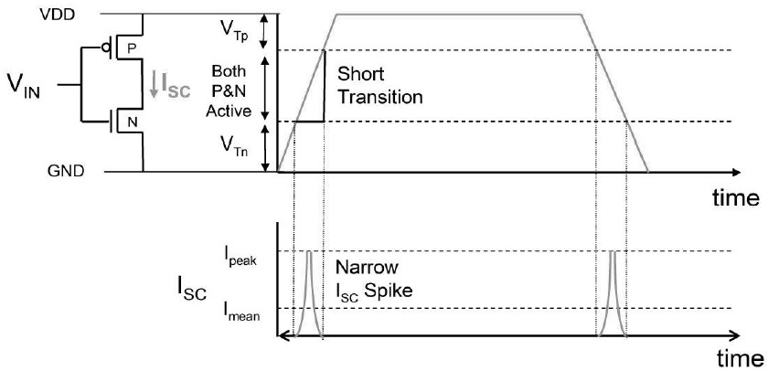
Short Circuit current

Slide 28
Short Circuit Currents Determinates
E_{sc} = t_{sc} V_{DD} I_{peak} P_{0→1}
P_{sc} = t_{sc} V_{DD} I_{peak} f_{0→1}
Duration and slope of the input signal, t_{sc}
I_{peak} determined by
  the saturation current of the P and N transistors which depend on their sizes, process technology, temperature, etc.
  strong function of the ratio between input and output slopes
    a function of C_{L}
Notes:
Direct path currents
tsc is when both devices are conducting – peak and duration of Isc both increase as the input slope decreases

Slide 29
Impact of C_{L} on P_{sc}
I_{sc} ≈ 0
I_{sc} ≈ I_{max}
Vin
Vout
Vin
Vout
C_{L}
C_{L}
Large capacitive load
Output fall time significantly larger than input rise time.
Small capacitive load
Output fall time substantially smaller than the input rise time.
Notes:
Left case - input moves through the transient region before the output starts to change. As the source-drain voltage of the PMOS is approximately 0 during that period, the device shuts off without ever delivering any current, so Isc is close to zero.
Right case - Drain-source voltage of PMOS equals VDD for most of the transition period, giving maximum Isc

Slide 30
I_{peak} as a Function of C_{L}
x 10⁻⁴
When load capacitance is small, I_{peak} is large.
C_{L} = 20 fF
I_{peak} (A)
C_{L} = 100 fF
Short circuit dissipation is minimized by matching the rise/fall times of the input and output signals - slope engineering.
C_{L} = 500 fF
x 10⁻¹⁰
time (sec)
500 psec input slope
Notes:
Making the output rise/fall time too large slows down the circuit and can cause short-circuit currents in the fan-out gates!
SLOPE ENGINEERING – is important for BOTH speed and power consumption
However, its not the optimum solution for a gate on its own (just keeps the overall short-circuit current within bounds). For a single inverter, see next slide . . .

Slide 31
P_{sc} as a Function of Rise/Fall Times
When load capacitance is small (t_{sin}/t_{sout} > 2 for V_{DD} > 2V) the power is dominated by P_{sc}
V_{DD}= 3.3 V
P normalized
V_{DD} = 2.5 V
If V_{DD} < V_{Tn} + |V_{Tp}| then P_{sc} is eliminated since both devices are never on at the same time.
V_{DD} = 1.5V
t_{sin}/t_{sout}
W/L_{p} = 1.125 μm/0.25 μm
W/L_{n} = 0.375 μm/0.25 μm
C_{L} = 30 fF
normalized wrt zero input rise-time dissipation
Notes:
For large capacitance values, all the power dissipation is devoted to charging and discharging the load capacitance. When the rise/fall times of inputs and outputs are equalized, most power dissipation is associated with dynamic power and only a minor fraction (<10%) is devoted to Psc.
At VDD=2.5V and VTs around 0.5V, an input/output slope ratio of 2 is needed to cause a 10% degradation in power dissipation.
Also notice that short-circuit current is reduced when we lower the supply voltage. In the extreme, when VDD < VTn + |VTp|, short-circuit current is completely eliminated.
With threshold voltages scaling at a slower rate than the supply voltage, Psc is becoming less important in vDSM.

Slide 32
Glitch Power Dissipation
Glitches are temporary changes in the value of the output – unnecessary transitions
They are caused due to the skew in the input signals to a gate
Glitch power dissipation accounts for 15% – 20 % of the global power

Slide 33
Glitch Power Dissipation
P = 1/2 .CL.Vdd . (Vdd – Vmin) ;
Vmin : min voltage swing at the output
Glitch power dissipation is dependent on
  Output load
  Input pattern
  Input slope

Slide 34
Glitch Power Dissipation
Hazard generation can be reduced by gate sizing and path balancing techniques
Hazard propagation can be reduced by using less number of inverters which tend to amplify and propagate glitches

Slide 35
Leakage (Static) Power Consumption
V_{DD} I_{leakage}
Vout
Drain junction leakage
Gate leakage
Sub-threshold current
Sub-threshold current is the dominant factor.
All increase exponentially with temperature!
Notes:
For drain junction: Leakage current per unit drain area typically ranges between 10 and 100 picoA/micron**2 at room temperature (25 degrees C) for 0.25 micron CMOS (1 million gates, each with drain area of 0.5 micron**2 = 0.125 milliW).
However, values increase with increasing junction temperature - exponentially! JS doubles for every 9 deg C! At 85 degrees C (commonly imposed upper bound for junction temperatures) the leakage currents increase by a factor of 60 over room temperature. As temperature is a strong function of the dissipated heat and its removal mechanisms – limit power heat and use chip packages that support efficient heat removal.
Have to be more concerned about sub-threshold current. The closer the threshold voltage is to zero, the larger the leakage current at VGS = 0 V. To offset this effect, threshold voltages are not scaled as aggressively as supply voltages (narrowing noise margins). Unfortunately, scaling the supply voltage and not scaling threshold hurts performance, esp as VDD approaches 2 VT.

Slide 36
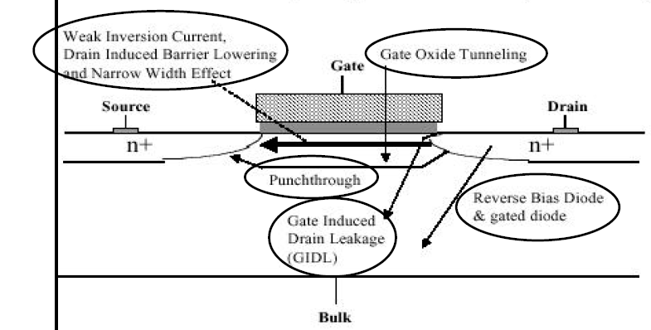
Source of Leakage Current
Keshavarzi,Roy,Hawkins(ITC1997)

Slide 37
Leakage as a Function of V_{T}
Continued scaling of supply voltage and the subsequent scaling of threshold voltage will make subthreshold conduction a dominate component of power dissipation.
10⁻²
An 90mV/decade V_{T} roll-off - so each 255mV increase in V_{T} gives 3 orders of magnitude reduction in leakage (but adversely affects performance)
10⁻⁷
10⁻¹²
Notes:
The choice of VT represents a trade-off between performance and static power dissipation. Process technologies with sharper turn-off characteristics (like SOI with slope factors closer to the ideal 60mV/decade) will become more attractive. With sizable static power dissipation, it is essential that non-active modules are powered-down (put in standby) by disconnecting the unit from the supply rails or by lowering the supply voltage.
There are other leakage factors that we are ignoring here including: Drain-Induced Barrier Lowering (I₃)
Gate-Induced Drain Leakage (I₄)
Punchthrough (I₅)
Narrow Width Effect (I₆)
Gate Oxide Tunneling (I₇)
Hot Carrier(I₈)

Slide 38
Leakage and V_{T}
CL018 G
CL018 LP
CL018 ULP
CL018 HS
CL015 HS
CL013 HS
V_{dd}
1.8 V
1.8 V
1.8 V
2 V
1.5 V
1.2 V
T_{ox} (effective)
42 Å
42 Å
42 Å
42 Å
29 Å
24 Å
L_{gate}
0.16 μm
0.16 μm
0.18 μm
0.13 μm
0.11 μm
0.08 μm
I_{DSat} (n/p) (μA/μm)
600/260
500/180
320/130
780/360
860/370
920/400
I_{off} (leakage) (ρA/μm)
20
1.60
0.15
300
1,800
13,000
V_{Tn}
0.42 V
0.63 V
0.73 V
0.40 V
0.29 V
0.25 V
FET Perf. (GHz)
30
22
14
43
52
80
Notes:
From MPR, June 2000, pp. 19 – Performance of various TSMC processes (G generic, LP low power, ULP ultra low power, HS high speed)

Slide 39
Reference
Kaushik Roy, Saibal Mukhopadhyay and Hamid Mahmoodi-Meimand,
“Leakage Current Mechanisms and Leakage Reduction Techniques in Deep-Submicrometer CMOS Circuits”, Proceedings of the IEEE, vol. 91, no. 2, February 2003

Slide 40
Power Dissipation in CMOS Circuits
P_{total} = P_{switching} + P_{short-circuit} + P_{leakage}
Due to charging and discharging capacitors (dynamic power consumption)
Due to direct paths
Due to leaking diodes and transistors
%75
%20
%5

Slide 41
Power Equations
P = C_{L} V_{DD}² f_{0→1} + t_{sc}V_{DD} I_{peak} f_{0→1} + V_{DD} I_{leakage}
f_{0→1} = P_{0→1} * f_{clock} P_{0→1} Probability of transition from 0 -> 1
Dynamic power
(decreasing relatively)
Short-circuit power
( decreasing absolutely)
Leakage power
( increasing)
Notes:
f0->1 represents the energy consuming transition

Slide 42
Basic principle of Low Power Design
Reducing P = C V_{dd}² f
Reduce switching frequency
-reduce unnecessary switching
-use alternate logic implementation
-use coding to reduce switching
Reduce
-Gate capacitance
-Overlap capacitance- arise from
lateral diffusion of the
drain and source impurities
-Diffusion capacitance
-Interconnect capacitance
Reduce V_{dd}
Quadratic relation
Reduce Threshold voltage
-will increase leakage current
and reduce noise immunity
-Dynamic voltage scaling

