Slide 1
Low Power
Adders and Multipliers
Dr. Elwin Chandra Monie
Powerpoint Templates

Slide 2
Full adder designs

Slide 3
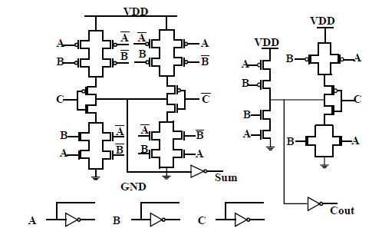
Conventional CMOS Logic

Slide 4
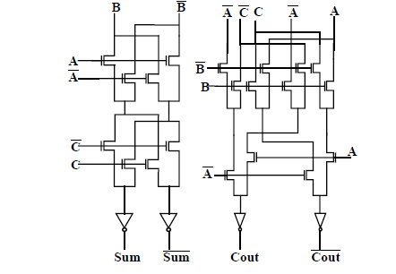
Complementary Pass transistor Logic (CPL)
When gate=0 output is
Undefined
P_{D}=V_{dd} V_{swing}C_{node}f
V_{swing} =V_{dd} –V_{th}
nMOS Pass transistor logic
Power less compared to
Conventional CMOS

Slide 5
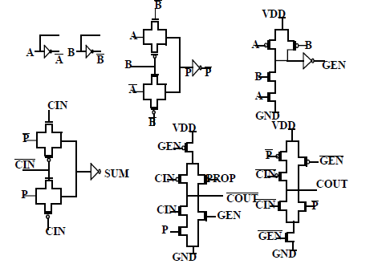
Double Pass Transistor Logic (DPL)
nMOS in parallel with pMOS

Slide 6
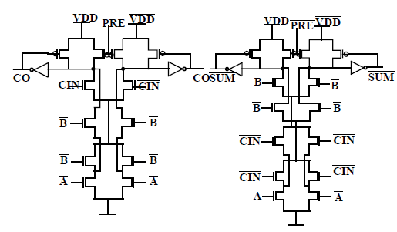
Differential Cascode Voltage Switch Logic (DCVSL)
Since input drive only nMOS
The input capacitance is two
Or three times smaller than
CMOS

Slide 7
Power, Delay performance of 4-bit ripple carry adder
Adder Design | Mean Power Dissipation mW | Delay (Worst Case) nSec | Mean Power-delay product
CSL | 0.422 | 6.125 | 2.585
CPL | 0.238 | 4.042 | 0.962
DPL | 0.305 | 3.345 | 1.020
DCVSL | 0.432 | 7.986 | 3.450

Slide 8
Power performance of 16-bit Adders
Adder type | Worst delay | Average transitions
Ripple carry | 33 | 90
Look-ahead carry | 10 | 100

Slide 9
Power performance in multipliers

Slide 10
Average gate output transitions
Multiplier type | Average gate output transitions |  |  | Power dissipation In 16 bit type mW
 | 8 bits | 16 bits | 32 bits
Array | 570 | 7224 | 99906 | 43.5
Split array | 569 | 4874 | 52221 | 38.0
Wallace | 549 | 3793 | 20055 | 32.0
Modified Booth | 964 | 3993 | 19542 | 41.3

Slide 12
Ref: Designing CMOS Circuits for Low Power
-Dimitrios Soudris, Christian Piguet and Costas Goutis
Springer International Edition, 2002

