Slide 1
Low power CDN

Slide 2
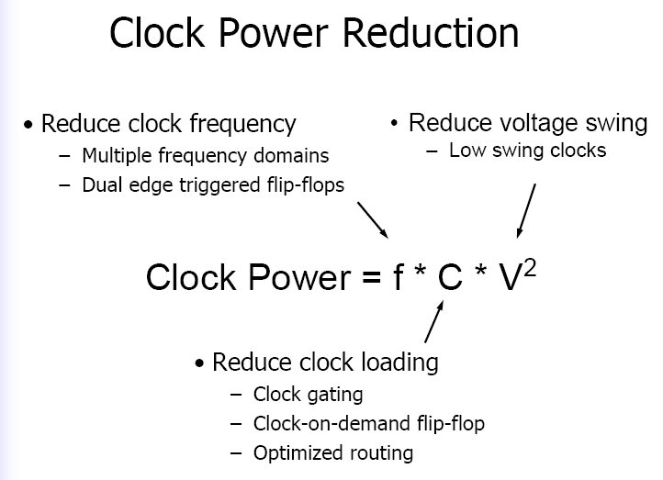

Slide 3
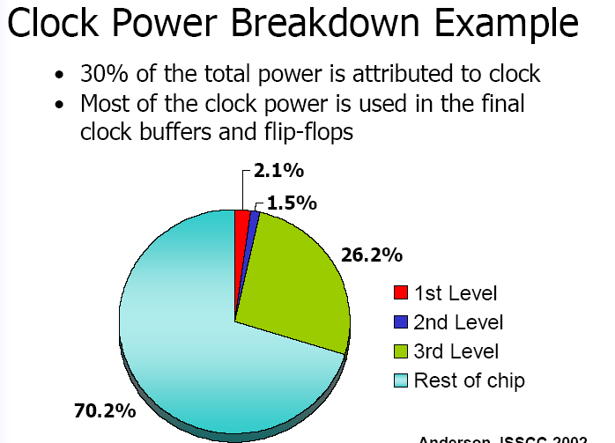

Slide 4
SPEED
Operate vdd at half rails
Data should operate at full rails

Slide 5
Smaller voltage to distribute the signal over the chip, and then converting this low voltage clock signal back to a higher voltage at the utilization points
Low vdd clock trees
Multiple Supply Voltages

Slide 6
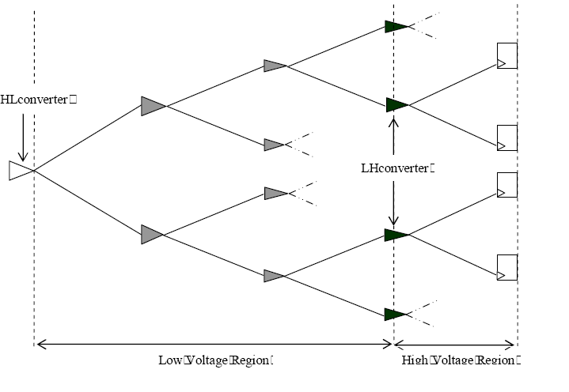

Slide 7
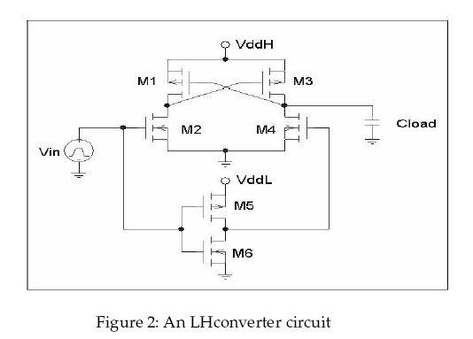
A Level Converter Using Multiple Supply Voltages

Slide 8
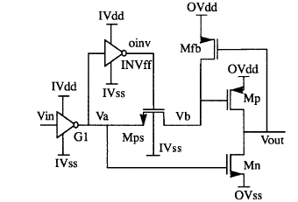
A Level Converter Using Multiple Supply Voltages

Slide 9
REDUCED SWING APPROACH

Slide 10
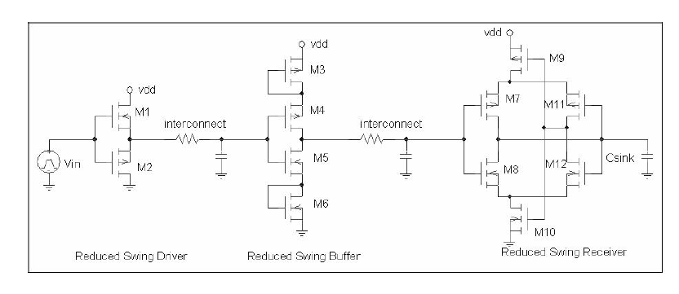
Level Converter Using a Reduced Clock Swing

Slide 12
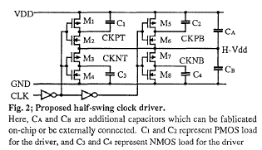
C₁+C_{A} Vdd C₁+C_{A} Vdd
Clk is low H-Vdd=------------------------ Clk is high H-Vdd= ----------------------
C₁+C₄+C_{A}+C_{B} C₂+C₃+C_{A}+C_{B}

Slide 13
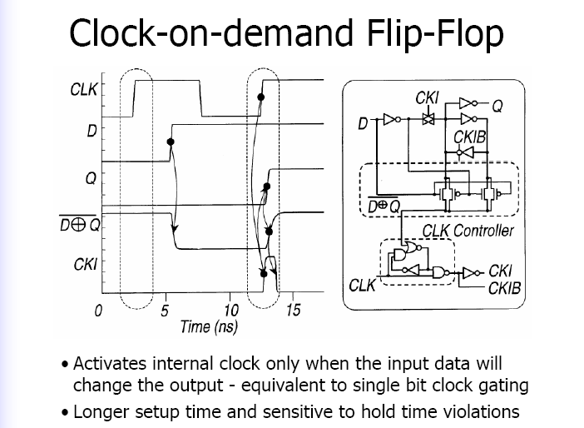

Slide 15
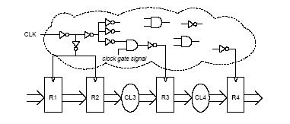
Clock gating

Slide 16
