Slide 1
Canonic Signed Digit Arithmetic
Elwin Chandra Monie
RMK Engineering College

Slide 4
A number represented in two’s complement is equivalent to representation in CSD
e.g -7/32= -1+1/2+1/4+1/32 ->1.11001 equal to -7/32= -1/4+1/32 -> 0.01̅001

Slide 6
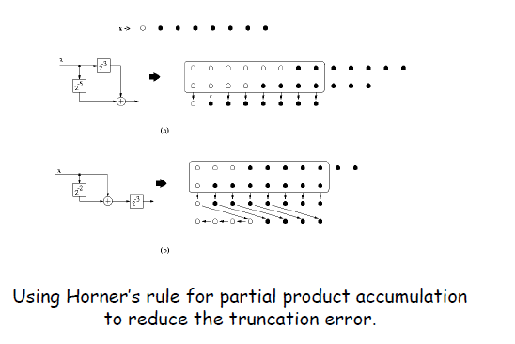

Slide 8
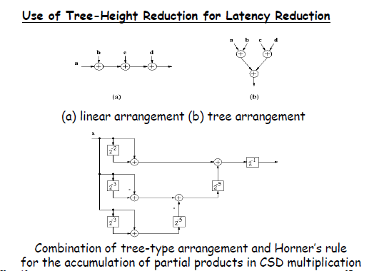

Slide 9
