Slide 1
Bit-Serial Architecture
Dr Elwin Chandra Monie
RMK Engineering College

Slide 2
Bit-Serial Multiplier
Lyon’s Bit-serial multiplier using Horner’s rule
This is non-causal and cannot be implemented

Slide 3
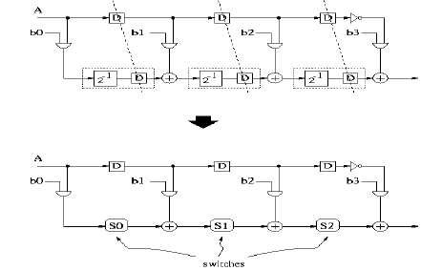
Pipelined bit-serial multiplier

Slide 4
Pipelined bit-serial multiplier…

Slide 5
a₃
b₃
a₃b₀
a₂b₁
a₁b₂
b₃
x₀
a₂
b₂
a₂b₀
a₁b₁
a₀b₂
a₁
b₁
a₁b₀
a₀b₁
a₀
b₀
a₀b₀
b₃ | b₂ | b₁ | b₀
a₃b₀
a₃b₁
a₂b₂
x₁
a₃b₂
x₂
x₃
where j is the bit of partial product pp^{i}

