Slide 1
Algorithmic Strength Reduction
in FIR filters and Transforms
Dr.Elwin Chandra Monie
R M K Engineering College

Slide 2
Why algorithmic strength reduction?
Reduction in hardware complexity by substructure sharing
Leads to reduction in area, power or iteration period
Enabled design of parallel FIR filters with less than linear increase in hardware
Leads to less hardware complexity in Transforms such as DCT

Slide 3
Parallel FIR filters

Slide 4
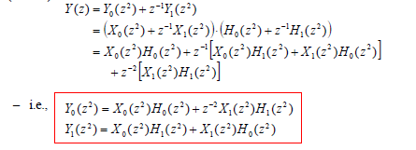
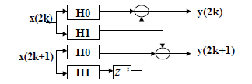
Parallel FIR filters….
2-Parallel FIR-> 2N multiplications and 2(N-1) additions

Slide 5
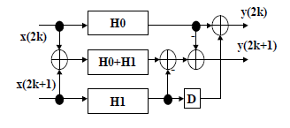
2-Parallel Fast FIR filter
In matrix form
(H₀+H₁) and (X₀+X₁) can be pre-calculated
Requires 3N/2=1.5N Multiplications and 3 (N/2 - 1)+4 =1.5N+1 Additions

Slide 6
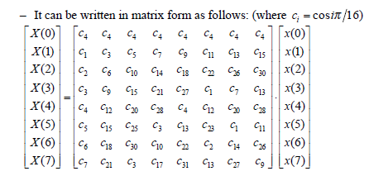
DCT Implementation
Consider 8-point DCT

Slide 7
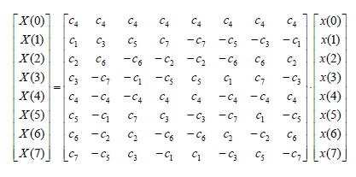
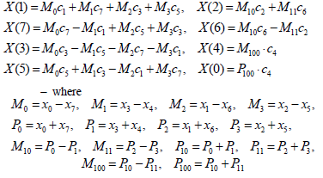
DCT Implementation…
Using trigonometric properties
Cos(∏±Ѳ)= - Cos(Ѳ)

Slide 8
c₁
X(1)
x(0)
+
+
+
c₇
P₀
c₇
x(7)
+
+
-
M₀
c₃
c₁
-
x(3)
+
+
P₁
c₅
c₅
x(4)
+
+
+
X(7)
-
c₃
_{M1}
c₅
-
-
x(1)
+
+
X(5)
c₃
+
P₂
c₃
x(6)
+
c₅
+
-
M₂
c₇
-
x(2)
+
+
+
X(3)
c₁
-
P₃
x(5)
+
c₇
+
M₃
-
c₂
+
+
X(2)
c₆
c₆
+
+
X(6)
-
c₂
-
c₄
X(0)
8 Point DCT
I Stage
+
+
c₄
+
+
X(4)
-
-

Slide 9
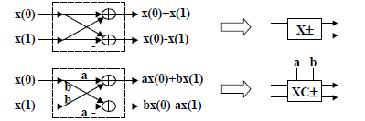
ax+by = ax+bx+by-bx= (x+y)b+(a-b)x 4Multiplications+ 2 Additions
bx-by = bx+by-ay-by=(x+y)b-(a+b)y to
5 Multiplications+5 Addditions
(4Additions pre-calculated)

Slide 10
c₁
c₇
x(0)
P₀
X(1)
X±
XC±
+
x(7)
M₀
c₃
c₅
x(3)
P₁
X±
XC±
_{M1}
+
X(7)
x(4)
c₃
-
c₅
x(1)
P₂
X(5)
X±
XC±
+
x(6)
M₂
c₇
c₁
x(2)
P₃
X(3)
X±
XC±
-
+
x(5)
M₃
c₂
c₆
X(2)
X±
XC±
X(6)
c₄
X(0)
8 Point DFT
II Stage
X±
X±
c₄
X(4)

Slide 11
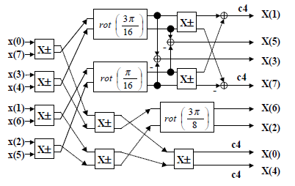
13 Multiplications required

Slide 12
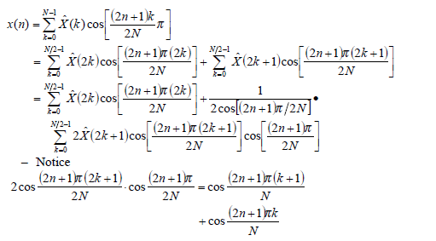
Fast DCT- Decimation in frequency
For 2^{n} point IDCT,

Slide 13
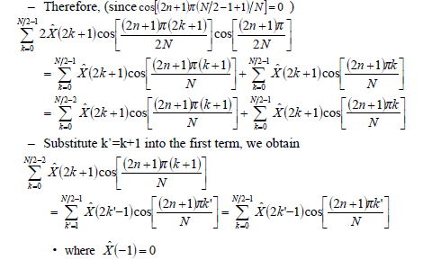
Fast DCT- Decimation in frequency..

Slide 14
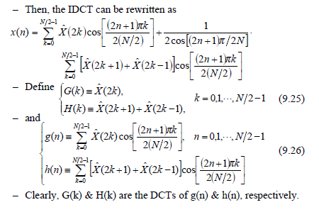
Fast DCT- Decimation in frequency…

Slide 15
Fast DCT- Decimation in frequency…

Slide 16
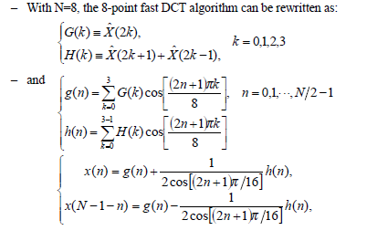
Fast 8-Point IDCT

Slide 17
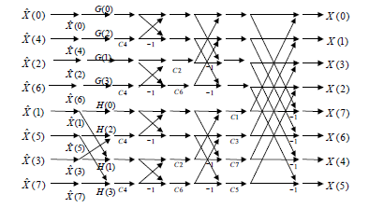
Fast 8-Point IDCT
(N/2) log₂ N multiplications
C_{i} =

Slide 18
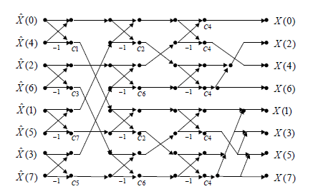
Fast 8-Point DCT
Transposing the structure for IDCT
Ref: W.Chen, C.Smith and S.C. Fralick, “A fast computation algorithm for the DCT”, IEEE Trans. on Communications, pp. 1004-1008, Sept., 1977

Slide 19
Rank order Filters
a₁
a₂
a₃
a₄
b₁
b₂
b₃
b₄
Odd
2x2 merge
largest
C&S
C&S
Even
2x2 merge
C&S
Smallest

Slide 20
Largest
a₁
a₂
b₁
b₂
C&S
C&S
C&S
Smallest
2x2 merge unit
Y_{r}(n) = r^{th} rank [x(n-N), x(n-N+1)……
x(n), x(n+1),……x(n+N] where r=1, 2…. 2N+1

Slide 21
2-parallel rank order filter
W=5 and L=2
y_{r}(2k) =r^{th} rank [x(2k-2), x(2k-1), x(2k), x(2k+1), x(2k+2)]
y_{r}(2k+1) = r^{th} rank [x(2k-1), x(2k), x(2k+1), x(2k+2), x(2k+3)]
x(2k+3)
x(2k+2)
1x1
Merge
x(2k+1)
x(2k)
x(2k-1)
2x2
merge
4x1
merge
y(2k+1)
1x1
Merge
1x1
merge
4x1
merge
2x2
merge
y(2k)
1x1
merge
x(2k-2)

Slide 22
Rank order filter with substructure sharing
y(2k) -2 -1 0 1 2
y(2k+1) -1 0 1 2 3
x(2k+3)
x(2k+2)
4x1
merge
y(2k+1)
1x1
Merge
x(2k+1)
x(2k)
x(2k-1)
2x2
merge
1x1
Merge
4x1
merge
y(2k)
x(2k-2)

Slide 23
Fast Convolution by Cook-Toom Algorithm
Fast convolution by algorithmic reduction
Based on Lagrange Interpolation Theorem
If β₀…. β_{n} are n+1 distinct points and f(β_{i}) for i=0,1…n are known, then there is a polynomial f(p) given by

Slide 24
Consider N-pt impulse response h = {h₀,h₁ …….h_{N-1}} and L-pt sequence x={x₀,x₁…….x_{L-1}}
The linear convolution of h and x can be expressed in terms of polynomial multiplication s(p)=h(p).x(p) where h(p) = h_{N-1}p^{N-1}+……+h₁p+h₀
x(p) = x_{L-1}p^{L-1}+….+x₁p+x₀
s(p) = s_{L+N-2}p^{L+N-2}+……+s₁p+s₀
Let {β₀…. β_{L+N-2} } be L+N-1 real numbers
If s(β_{i} ) for i=0……L+N-2 are known, then s(p) can be calculated

Slide 25
Cook-Toom Algorithm
Choose L+N-1 different real numbers
Compute h(β_{i}) and x(β_{i}) for i=0,1….L+N-2
Compute s(β_{i})=h(β_{i}).x(β_{i}) for i=0,1…..L+N-2
Compute s(p) using
if β_{i} are chosen properly then only 3rd step involve multiplications (L+N-1)
Multiplications are reduced from LN to L+N-1

Slide 26
Example : 2x2 Linear convolution
β is taken as {0,1,-1}
h(p)=h0+h₁p and x(p)=x₀+x₁p
s(p)=h(p)x(p)
= s₀+s_{i}p+s₂p²
In matrix form

Slide 27
β₀ = 0 h(β₀)= h₀ x(β₀) = x₀
β₁ =1 h(β₁)= h₀ + h₁ x(β₁)= x₀+x₁
β₂ = -1 h(β₂)= h₀- h₁ x(β₂)= x₀- x₁
s(β₀ )=h(β₀) x(β₀) s(β₁ )=h(β₁) x(β₁) s(β₂)=h(β₂) x(β₂)

Slide 28
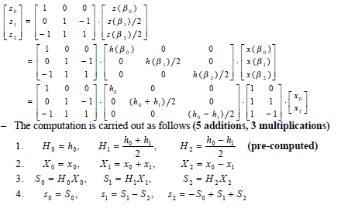

Slide 29
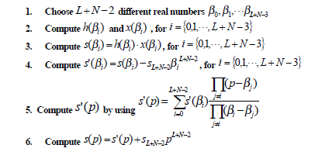
Modified Cook-Toom Algorithm

Slide 30
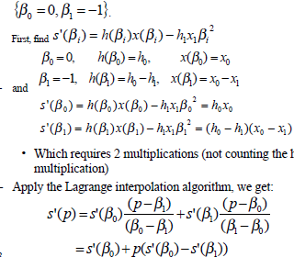
2x2 Convolution

Slide 31
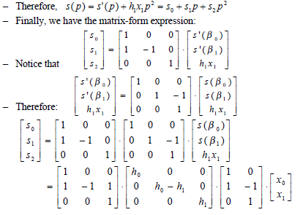

Slide 32
