Slide 1
Pipelined Adaptive Filters

Slide 2
Introduction to Adaptive Filters
Adaptive filter:
Filter learns the statistics of their operative environment and continually adjust its coefficient accordingly
Widely used in communication, DSP, and control system
Noise cancellation
Channel equalizer
System identification

Slide 3
Introduction to Adaptive Filters….
If y(n) is the signal output and the input is u(n) to a filter with M taps
Find the weights of the optimum filter in the sense that the output signal is as close as possible to the desired signal d(n) in terms of mean squared error (MSE)

Slide 4
Steepest Descent Algorithm

Slide 5
Steepest Descent Algorithm….

Slide 6
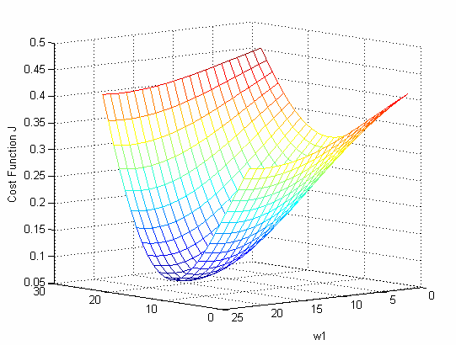
Error performance in terms of weights

Slide 7
Steepest Descent Algorithm….

Slide 8
Steepest Descent Algorithm….
The direction opposite of the gradient (-∇) will point towards the minimum point on the error surface

Slide 9
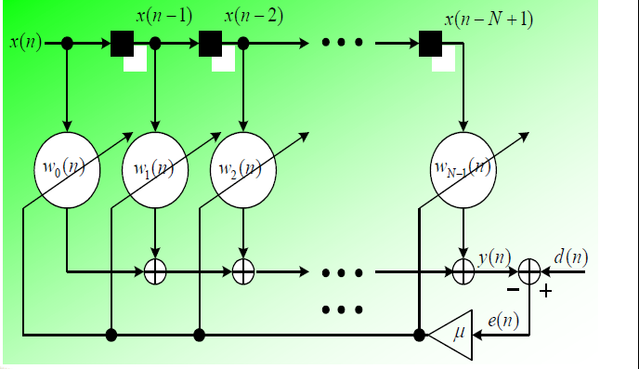
Least Mean Square (LMS) algorithm

Slide 10
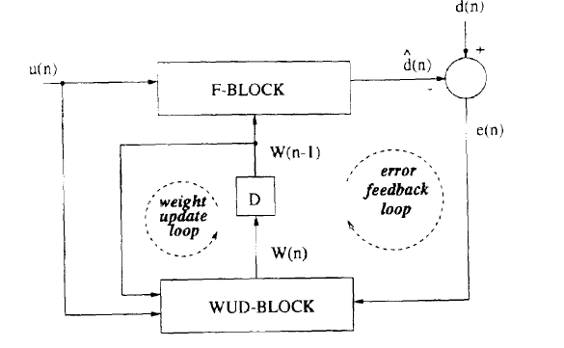
Adaptive filter structure

Slide 11
Relaxed look-ahead pipelining
Relaxed look-ahead Approximate
In adaptive filtering, concerned with stochastic behaviour rather than input-output mapping is important
Consider
RHS have a product and sum- approximate each one

Slide 12
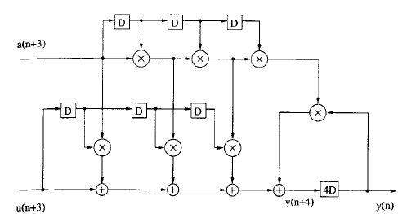
Adaptive Filter Design

Slide 13
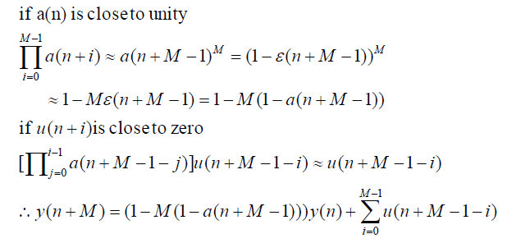
Relaxed product
a(n) =1-ε(n)
M= 4
y(n+4)=(1- 4(1-a(n+3))) y(n) + ∑³_{i=0} u(n+3-i)

Slide 14
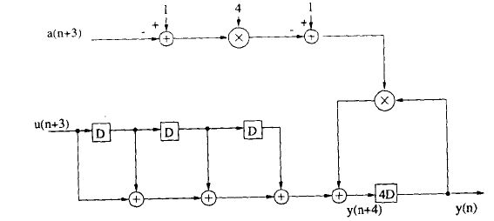

Slide 15
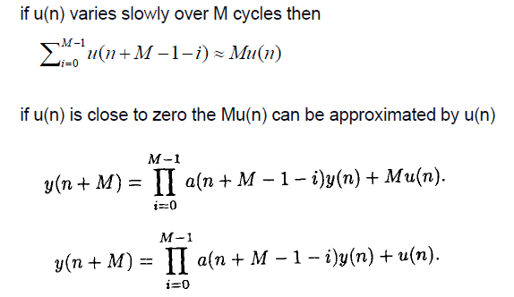
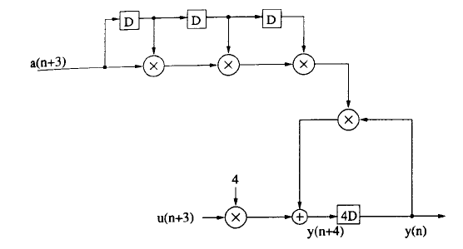
Sum Relaxation
M=4
y(n+4)=a(n+3)a(n+2)a(n+1)a(n)+u(n)

Slide 16
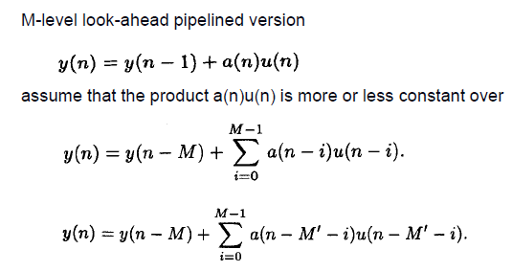
Delay Relaxation

Slide 17
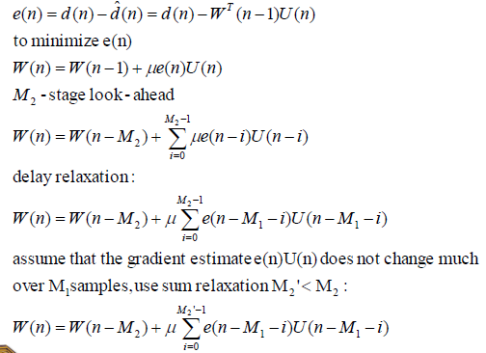
Pipelined LMS Adaptive Filter

Slide 18
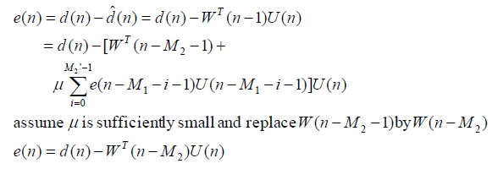
Pipelined LMS Adaptive Filter…..

Slide 19
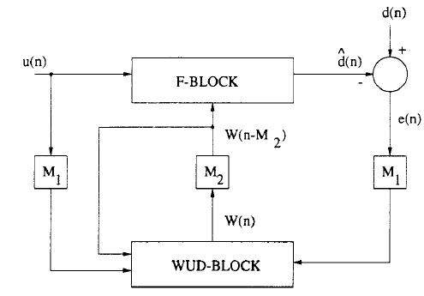
Pipelined LMS Adaptive Filter…..

